Slide 1

ALL
IN
WHEN GRACE CLAIMS YOUR WHOLE LIFE
Stewardship and Mission
2 Corinthians 8–9
NORTH AMERICAN DIVISION
Annual Stewardship Sabbath
Notes:
Timing: 1 minute. Welcome the congregation to the annual NAD Stewardship Sabbath. Explain that Stewardship Sabbath is an annual discipleship renewal, not a one-day fundraising drive. Introduce All In as a message about the whole life responding to the grace of God.

Slide 2
THE MESSAGE IN ONE BREATH
GRACE CAME DOWN.
GRACE TAKES OVER.
GRACE GOES OUT.
ALL IN WITH JESUS
“Though He was rich, yet for your sakes He became poor.” 2 Corinthians 8:9 NKJV
02
Notes:
Timing: 2 minutes. Teach the refrain and invite the congregation to repeat it: Grace came down. Grace takes over. Grace goes out. Explain that these movements define All In. Jesus gave Himself fully for us. Grace claims our whole lives. Surrendered lives become available for mission. Read or summarize 2 Corinthians 8:9 in the NKJV.

Slide 3
01
GRACE CAME DOWN
BEFORE WE
EVER GAVE,
GOD GAVE.
Jesus went all in for us.
Stewardship begins with the Gift.
2 Corinthians 8:9 John 3:16
03
Notes:
Timing: 6 minutes. Point one: Grace came down. Before we ever gave, God gave. At the cross, Jesus exchanged heaven’s riches for our poverty so that we could receive the riches of salvation. He held nothing back. Jesus went all in for us. Stewardship grows from gratitude for a salvation we could never purchase. Repeat: Grace came down.

Slide 4
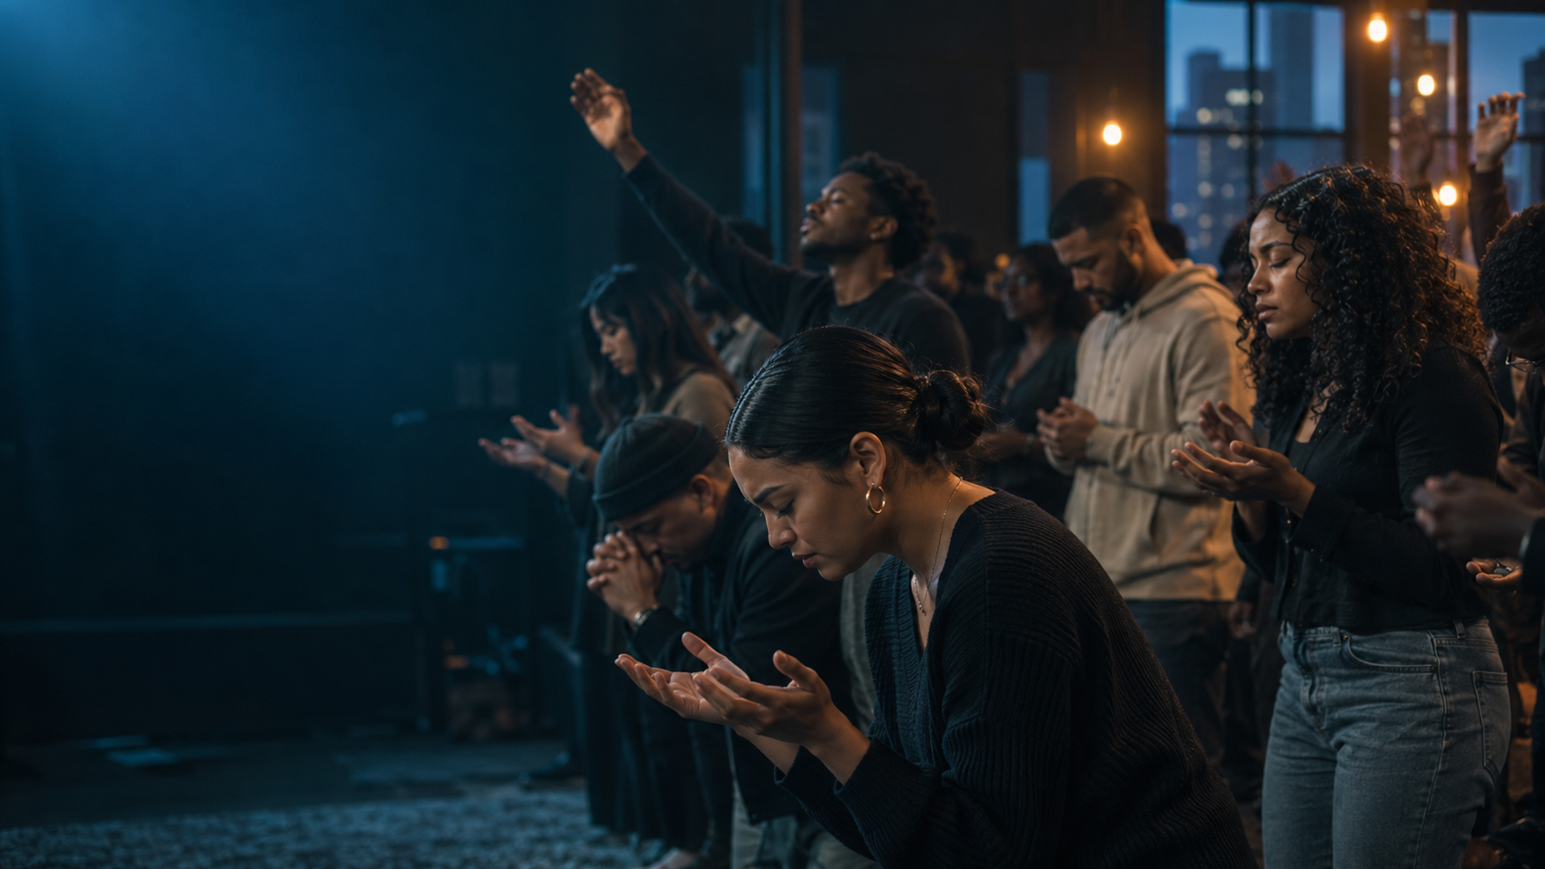
02
GRACE TAKES OVER
GOD DOESN’T
JUST WANT
WHAT’S IN
OUR HANDS.
HE WANTS US.
“They first gave themselves to the Lord.”
2 Corinthians 8:5 NKJV
04
Notes:
Timing: 7 minutes. Point two: Grace takes over. God does not merely want what is in our hands; He wants us. The Macedonians first gave themselves to the Lord. This is the conversion at the center of stewardship and the meaning of going all in with Christ. Jesus asks for the whole person. Going all in means withholding nothing He has entrusted to us. Repeat: Grace takes over.

Slide 5
WHAT ALL IN LOOKS LIKE
7
TANGIBLE
TIME
TEMPLE
Ts
TALENTS
TREASURE
NAD STEWARDSHIP
FOUNDATIONAL
TRUST
THEOLOGY
TESTIMONY
Everything entrusted. Everything surrendered. Everything available.
05
Notes:
Timing: 4 minutes. Grace takes over the whole life. The NAD Stewardship 7Ts put our Adventist understanding of stewardship into daily practice. The tangible dimensions are Time, Temple, Talents, and Treasure. The foundational dimensions are Trust, Theology, and Testimony. Time asks who owns my schedule. Temple asks how I care for the life and body God gave me. Talents asks how my gifts can serve. Treasure asks whether my resources are available to God. Trust gives courage to obey. Theology keeps stewardship rooted in who God is. Testimony turns a surrendered life into visible evidence of Jesus. The seven Ts are seven ways one surrendered life says, Jesus, I am Yours. Source: https://www.nadadventist.org/beliefs/stewardship/

Slide 6

03
GRACE GOES OUT
EVERY
SURRENDERED
STEWARD
BECOMES PART
OF GOD’S
MISSION.
PLANNED CHEERFUL
ACCOUNTABLE CHRIST-CENTERED
2 Corinthians 9:6–15
06
Notes:
Timing: 6 minutes. Point three: Grace goes out—every surrendered steward becomes part of God’s mission. This is where an all-in life moves outward. In 2 Corinthians 9, generosity supplies real needs, multiplies thanksgiving, and causes people to glorify God. Biblical giving is planned, cheerful, accountable, and centered on Christ. The church’s credibility matters, which is why Paul included trusted companions and transparent administration. Widen the application: our time, health, abilities, money, faith, beliefs, and story all become mission resources. Repeat: Grace goes out.

Slide 7
WILL YOU GO ALL IN?
Grace came down for you.
Will grace take over and go out through you?
RECEIVE CHRIST
Give your life to Jesus for the first time.
REDEDICATE EVERYTHING
Place your whole life back in His hands.
GRACE CAME DOWN. GRACE TAKES OVER. GRACE GOES OUT.
By grace, I am all in.
07
Notes:
Timing: 4 minutes. Conclusion and appeal. Gather the movement: Grace came down because Jesus went all in for us. Grace takes over when we go all in with Christ. Grace goes out when an all-in life becomes available for mission. Ask everyone to open their hands as a sign of surrender. First appeal: receive Christ and say, Jesus, I am all in. Second appeal: rededicate the whole life. Name the seven areas quietly: Time, Temple, Talents, Treasure, Trust, Theology, and Testimony. Invite the planned response. Close in prayer: Lord Jesus, because You gave Yourself completely for us, we give ourselves to You. By grace, we are all in. Take our whole lives and send us in Your mission. Amen.

