Slide 1
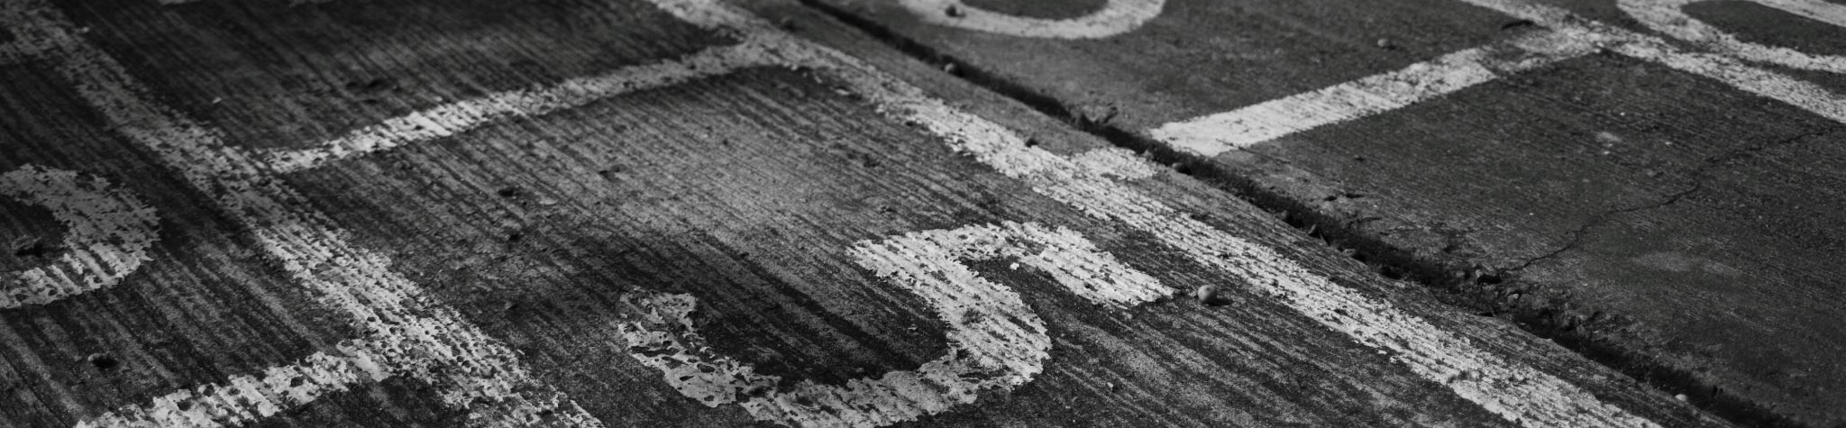
Assets and MOTIVES

Slide 2
According to Maslow’s theory of motivational behavior, we first strive to fulfill our physiological needs.

Slide 3
After the physiological needs, what comes next is safety (order, security, etc.).

Slide 4
The need for safety is followed by the need for love and belonging. After that we seek esteem.

Slide 5
The pinnacle of Maslow’s pyramid is self-actualization.

Slide 6
LEVEL ONE: Self-Interest

Slide 7
Matthew 8:5-10 NIV
When Jesus had entered Capernaum, a centurion came to him, asking for help. (6) “Lord,” he said, “my servant lies at home paralyzed and in terrible suffering” (7) Jesus said to him, “I will go and heal him.” (8) The centurion replied, “Lord, I do not deserve to have you come under my roof. But just say the word, and my servant will be healed. (9) For I myself am a man under authority, with soldiers under me. I tell this one, ‘Go,’ and he goes; and that one, ‘Come,’ and he comes. I say to my servant, ‘Do this,’ and he does it.”

Slide 8
LEVEL Two: Obedience

Slide 9
Matthew 8:5-9 NIV
When Jesus had entered Capernaum, a centurion came to him, asking for help. “Lord,” he said, “my servant lies at home paralyzed and in terrible suffering.”

Slide 10
Matthew 8:5-9 NIV
Jesus said to him, “I will go and heal him.” The centurion replied, “Lord, I do not deserve to have you come under my roof. But just say the word, and my servant will be healed.

Slide 11
Matthew 8:5-10 NIV
For I myself am a man under authority, with soldiers under me. I tell this one, ‘Go,’ and he goes; and that one, ‘Come,’ and he comes. I say to my servant, ‘Do this,’ and he does it.”

Slide 12
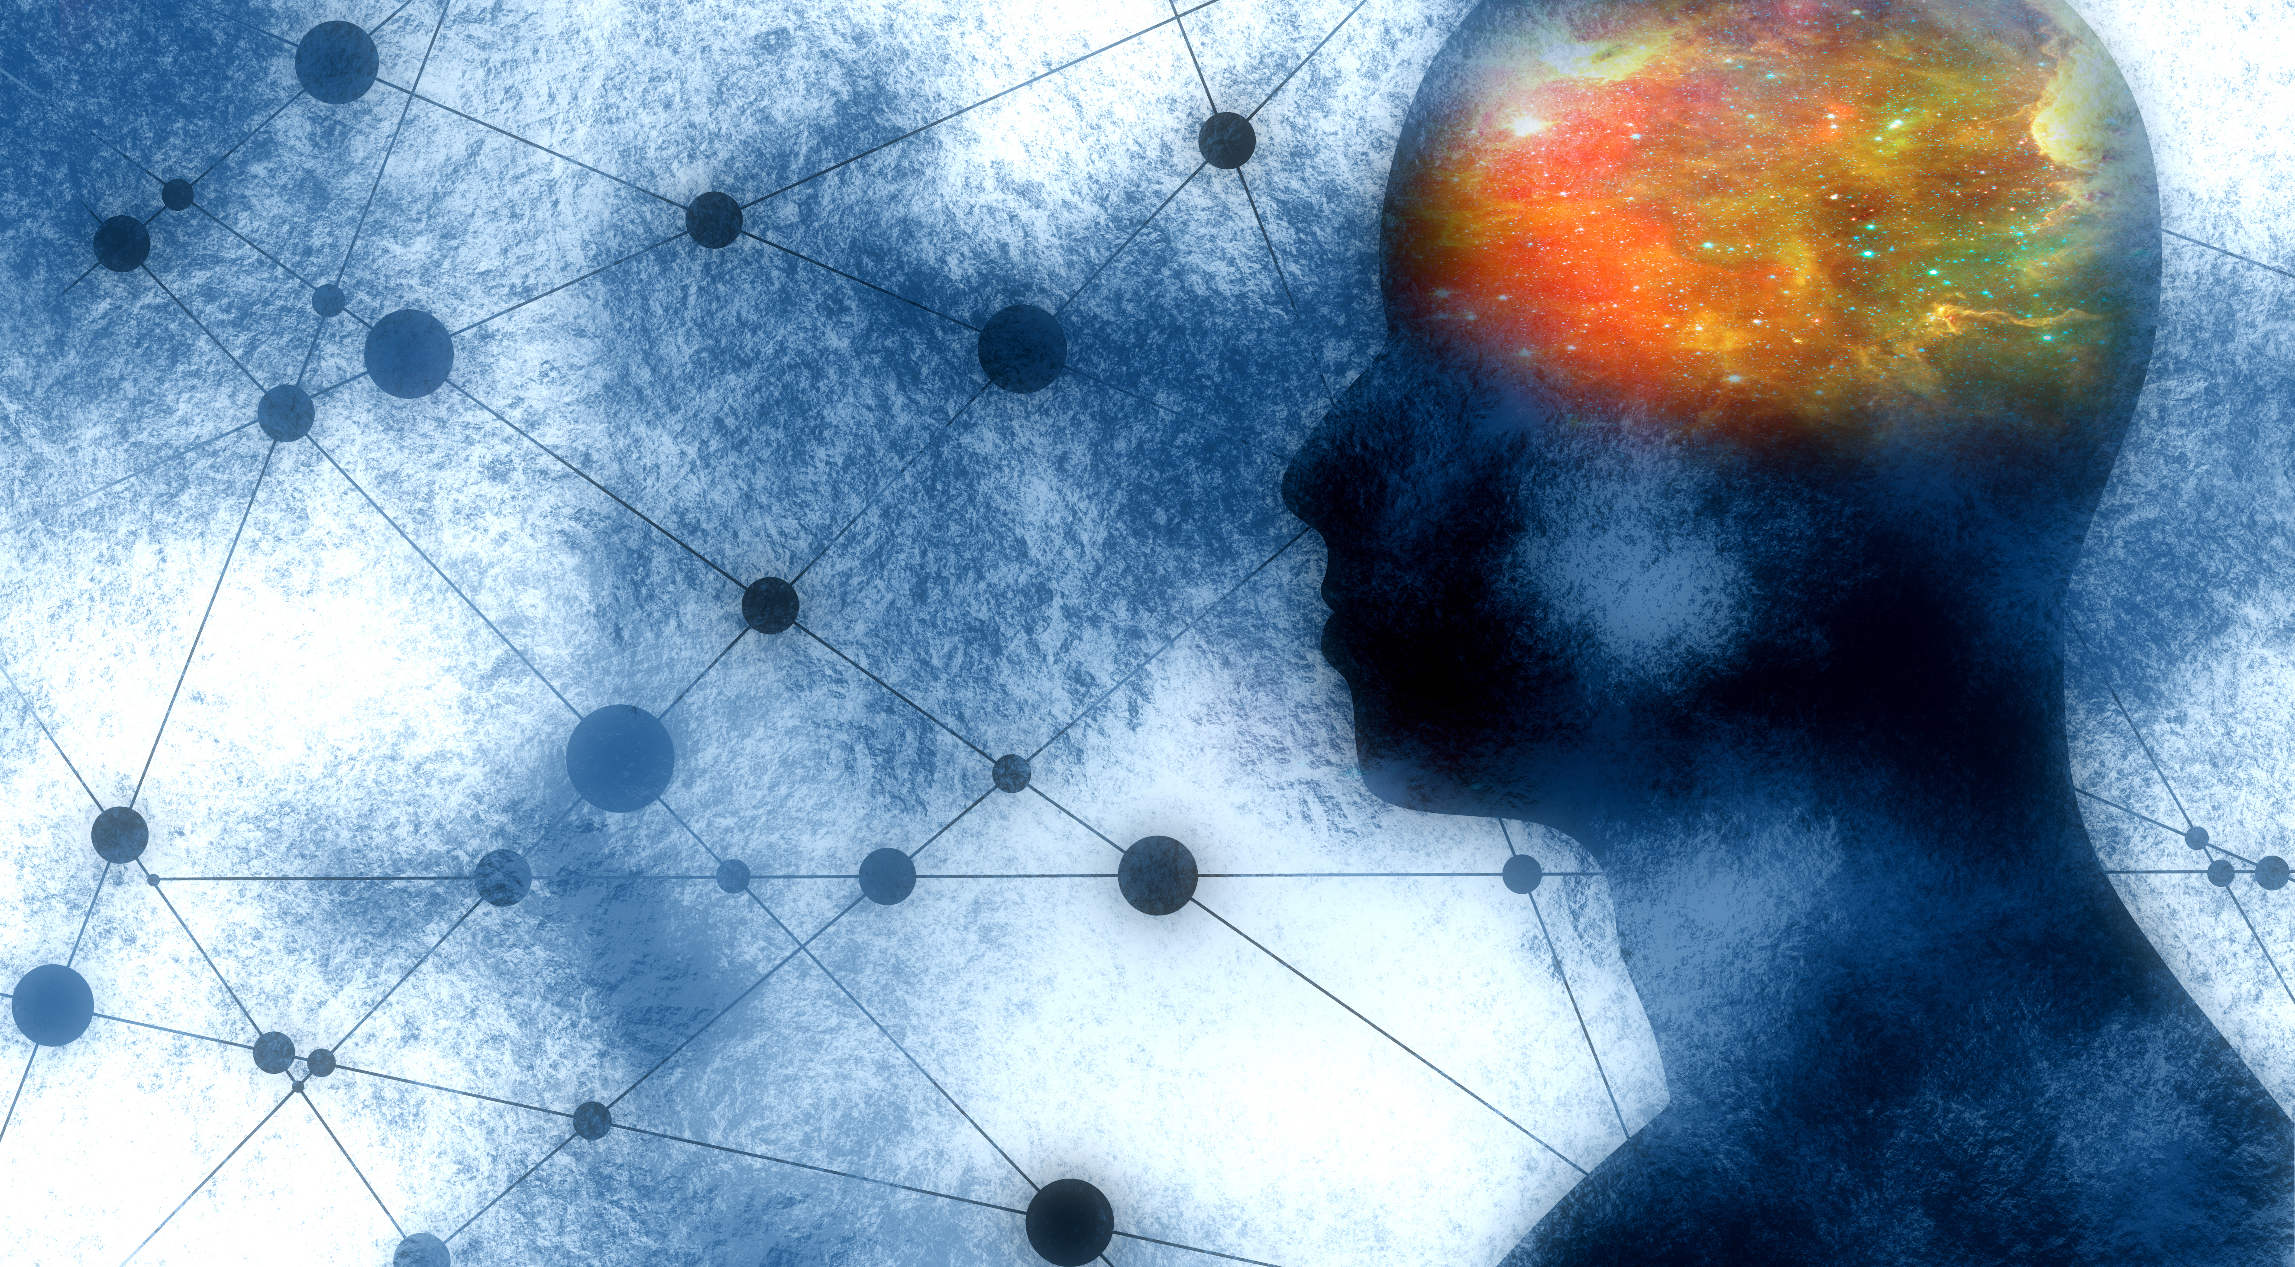
“These brain studies show the profound state of joy and delight that comes from giving to others. It doesn’t come from dry action– where the act is out of duty in the narrowest sense, like writing a check for a good cause. It comes from working to cultivate a generous quality– from intera https://www.istockphoto.com/vector/silhouette-of-a-mans-head-gm898672018-247983868 cting with people. There is the smile, the tone in the voice, the touch on the shoulder. We’re talking about altruistic love.”
-Jeanie Lerche Dacis “The Science of Good Deeds”
People who gave altruistically had a 44% reduction in early death when compared to those who gave out of a sense of duty.

Slide 13
LEVEL Three: BIBLICAL UNDERSTANDING

Slide 14
Psalm 24:1
“The earth is the Lord’s, and everything in it, the world, and all who live in it.”

Slide 15
Ecclesiastes 5:15
“Everyone comes naked from their mother’s womb,
and as everyone comes, so they depart.
They take nothing from their toil
that they can carry in their hands.”

Slide 16
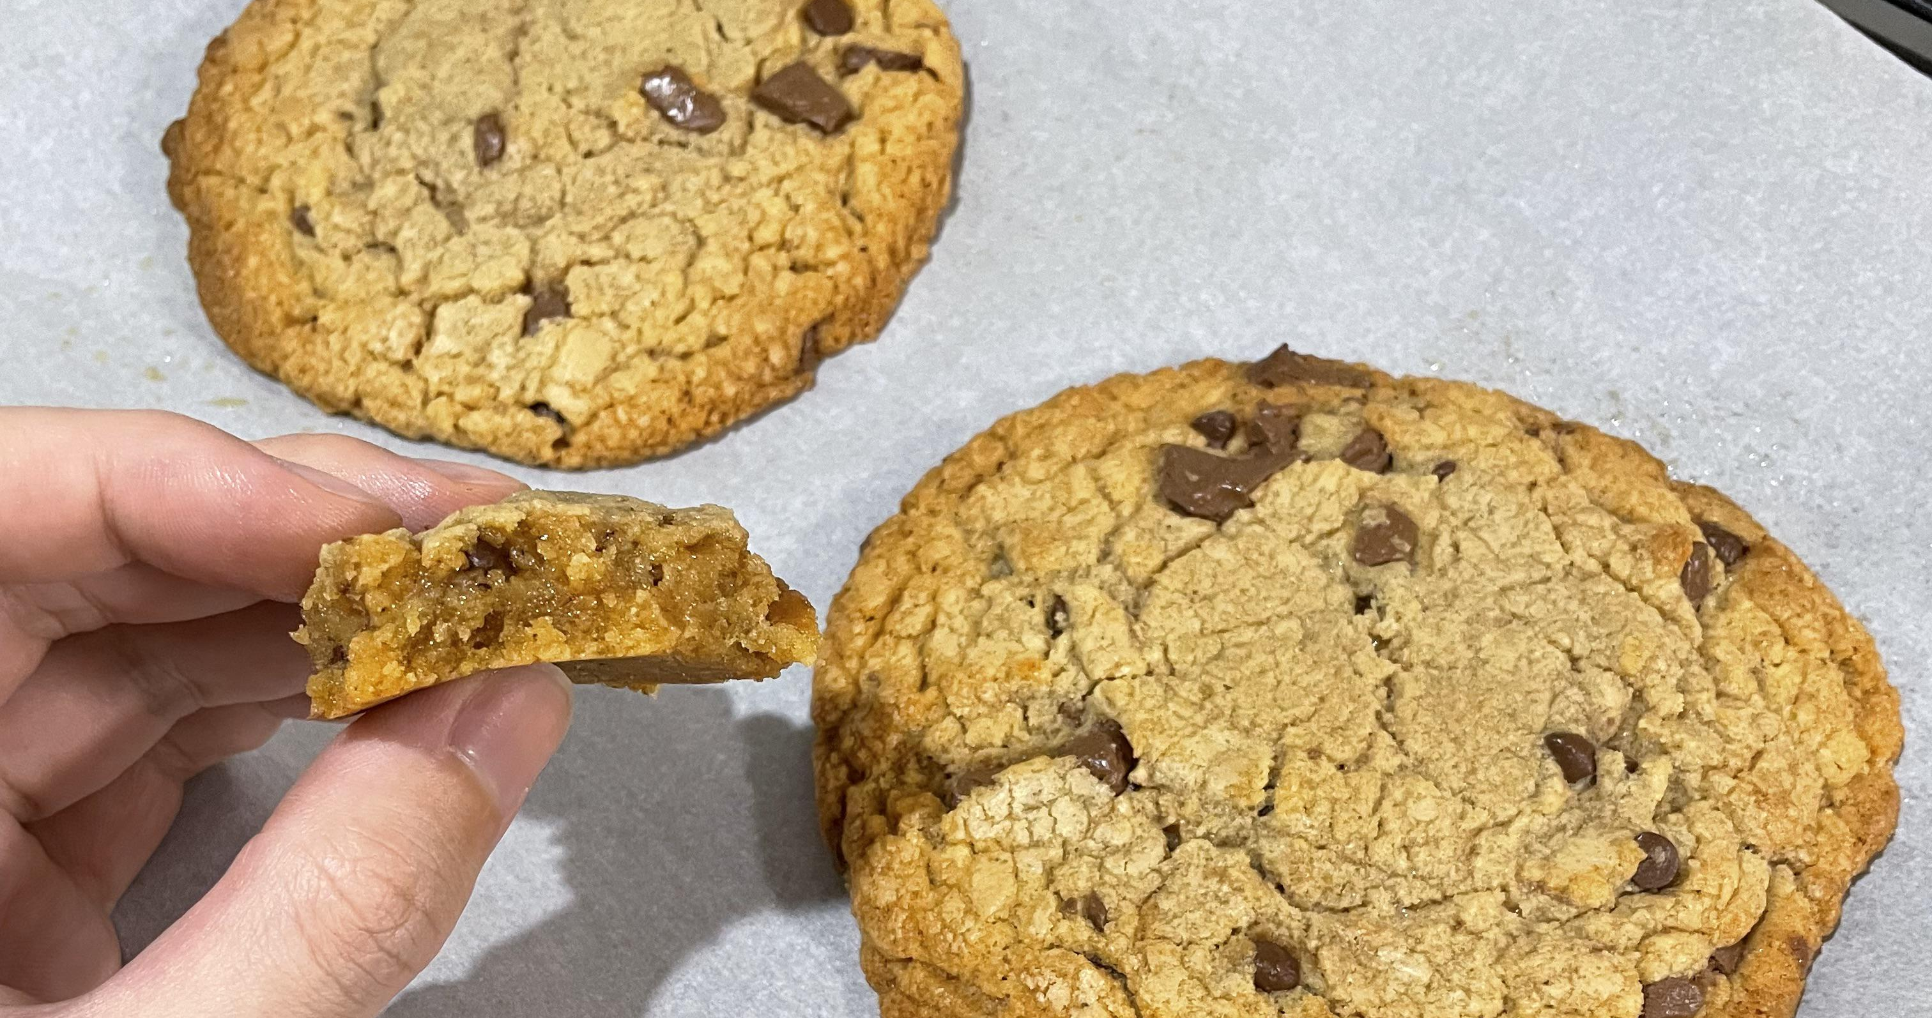

Slide 17
Matthew 6:19 - 21
“Do not store up for yourselves treasures on earth, where moths and vermin destroy, and where thieves break in and steal. But store up for yourselves treasures in heaven,

Slide 18
Matthew 6:19 - 21
where moths and vermin do not destroy, and where thieves do not break in and steal. For where your treasure is, there your heart will be also.”

Slide 19
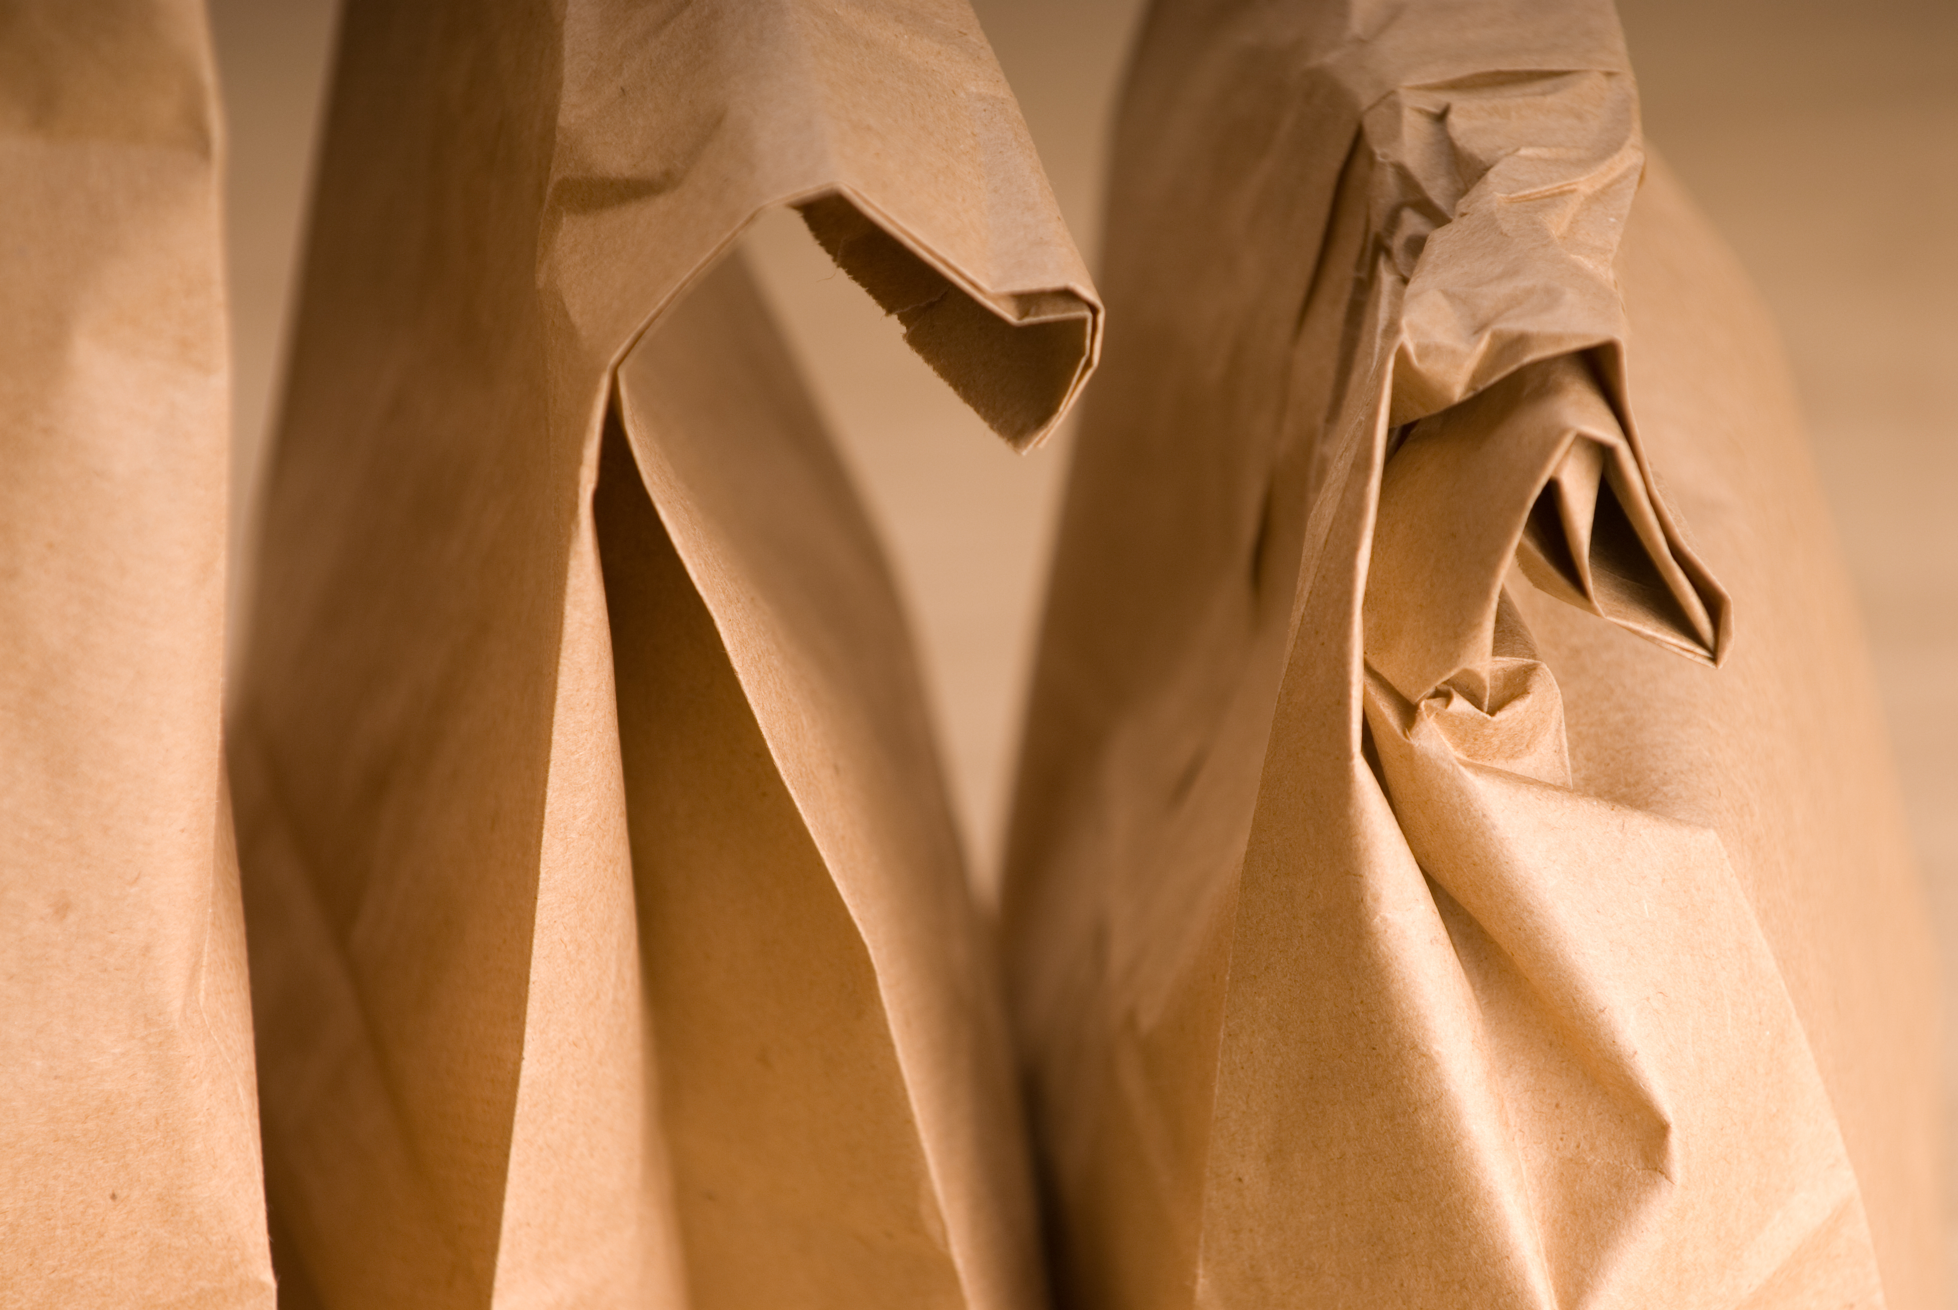
https://www.istockphoto.com/photo/bag-lunch-gm172201593-3302290

Slide 20
LEVEL Four: Gratitude

Slide 21
Psalm 116:12
“What shall I return to the Lord
for all his goodness to me?”

Slide 22
Milo Kauffman writes, “Christian stewardship most certainly is not church legislation nor a scheme to deprive men of their cash. It is the natural consequence of an experience with God—the natural reaction of the human heart that has been touched by the divine spirit.”

Slide 23
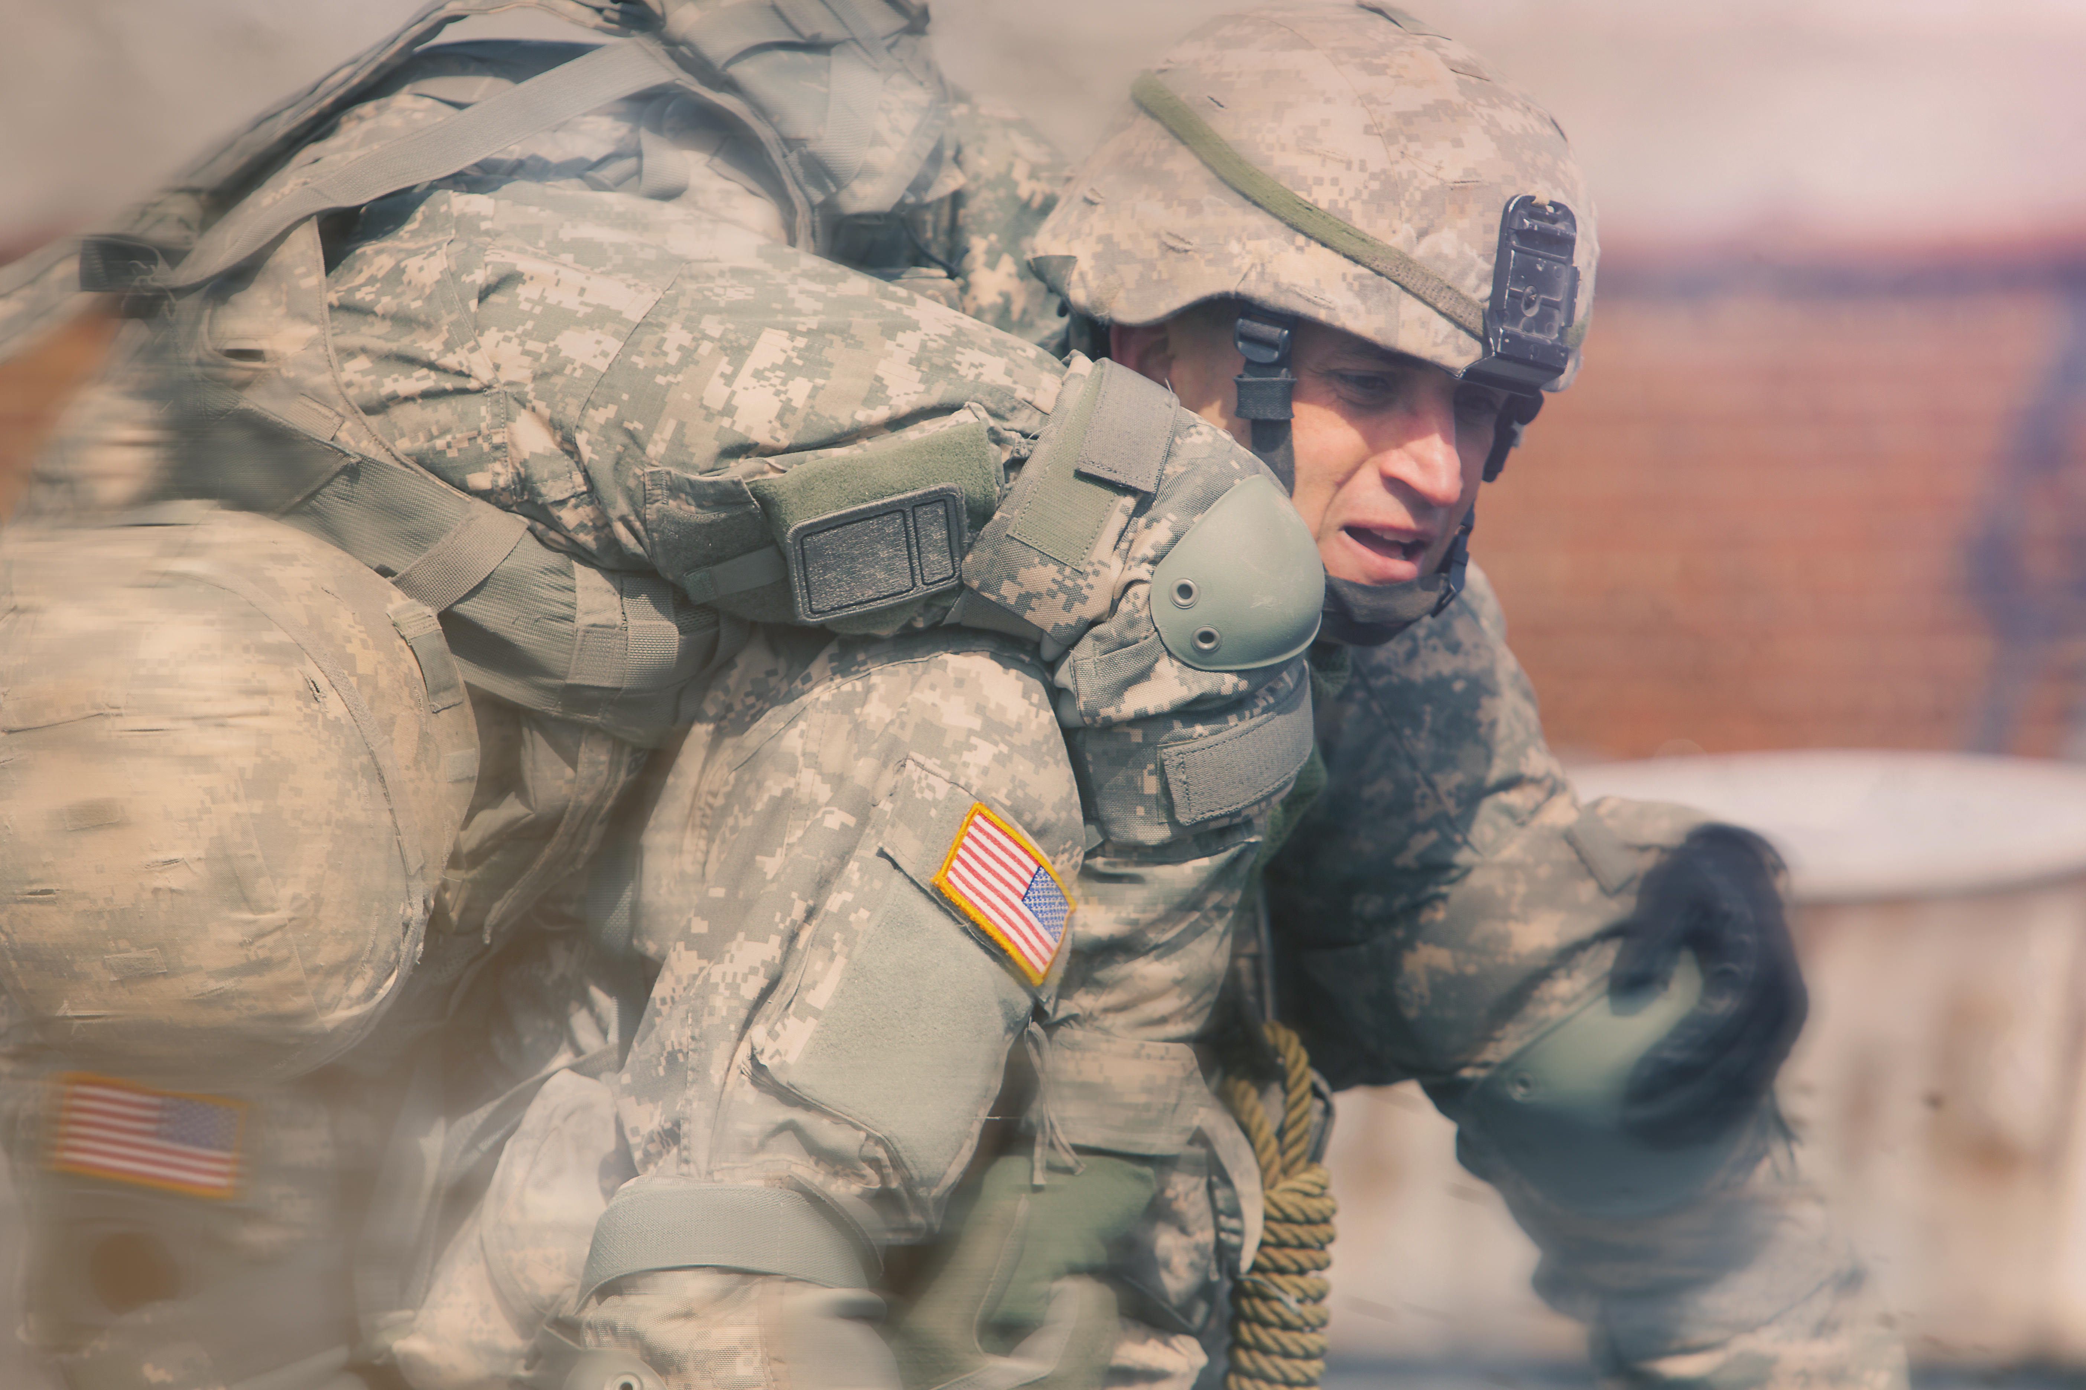

Slide 24
“To think that our precious son gave his life for that!”

Slide 25
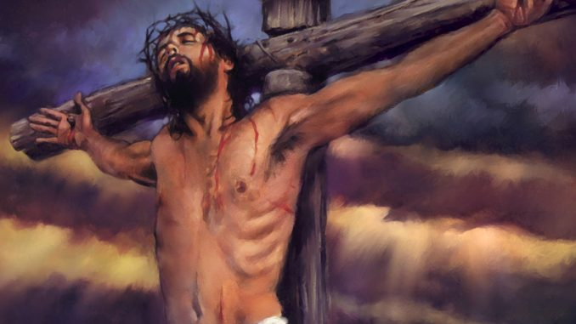

Slide 26
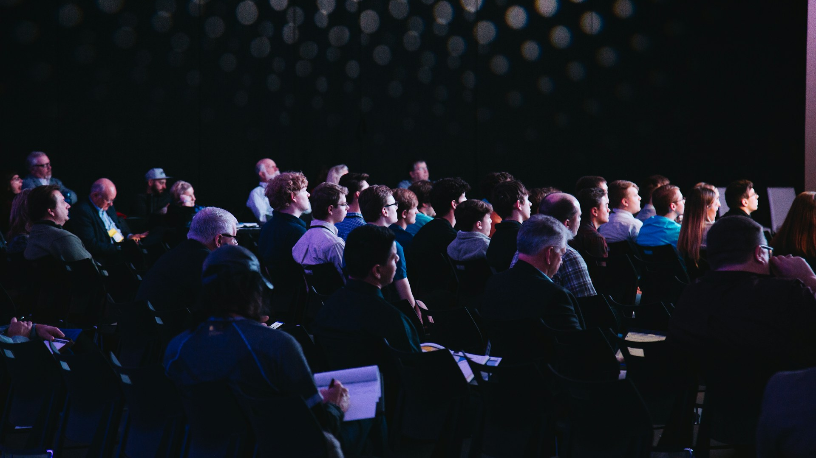
Photo by Headway on Unsplash

Slide 27
Ellen White (5T 285)
“When the light and love of Jesus illuminate the hearts of His followers, there will be no occasion for urging or begging their money or their service.”

Slide 28
LEVEL Five: Sacrificial Love

Slide 29
2 Corinthians 9:6-7
“Remember this: Whoever sows sparingly will also reap sparingly, and whoever sows generously will also reap generously.

Slide 30
2 Corinthians 9:6-7
“Each of you should give what you have decided in your heart to give, not reluctantly or under compulsion, for God loves a cheerful giver.”

Slide 31
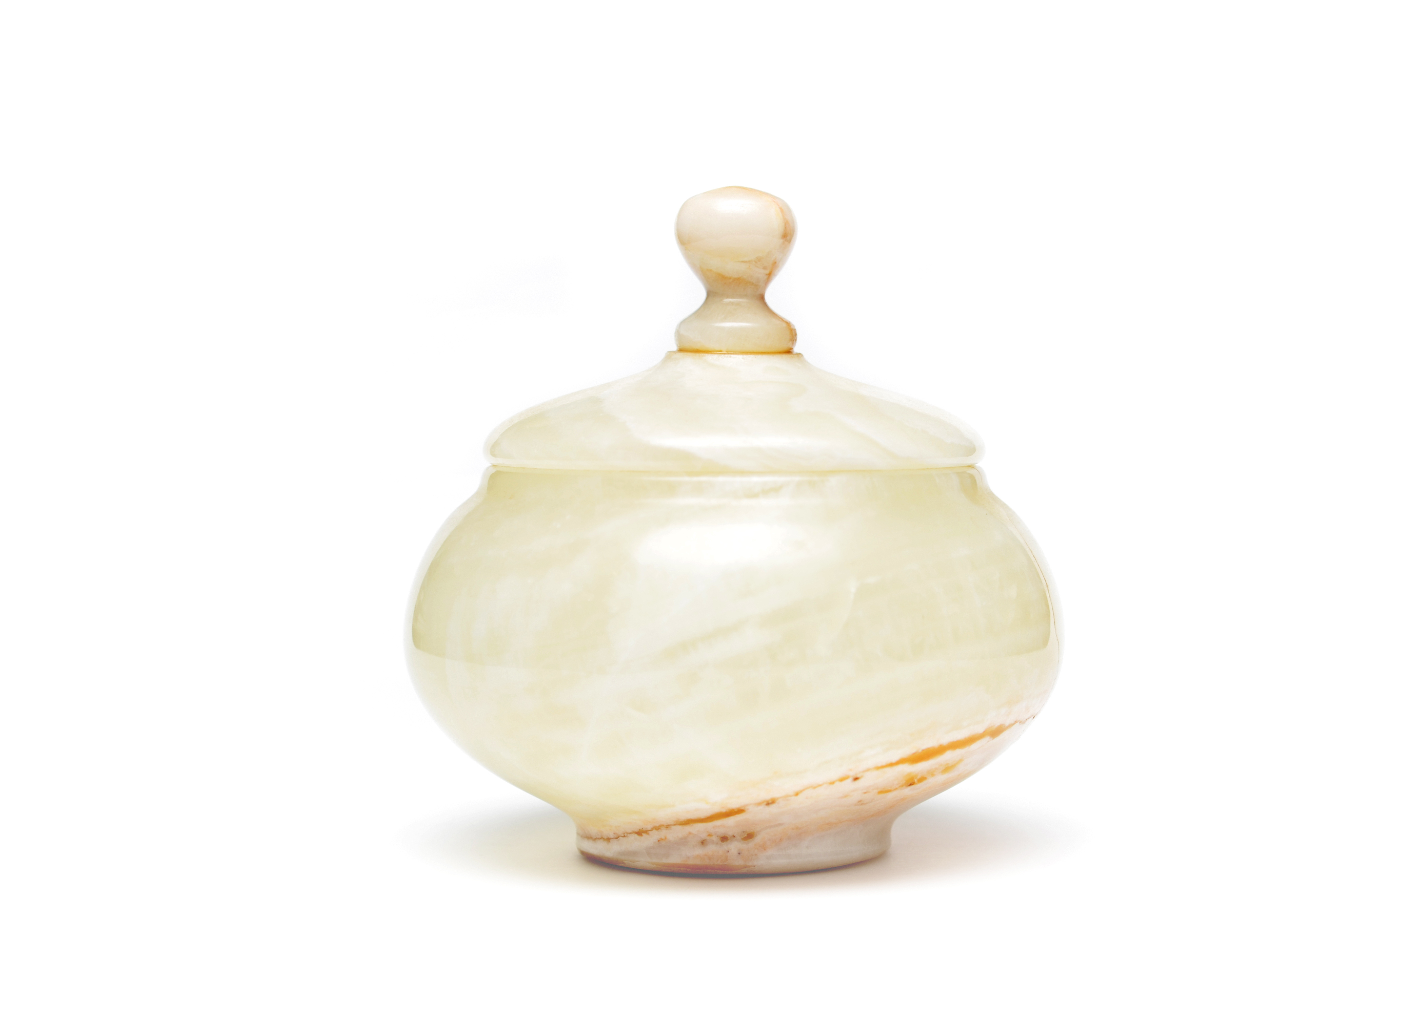

Slide 32
Love made me do it!

