Slide 1

God is the Great Giver

Slide 2

Jesus in Matthew 5:48 says some rather startling words. He says,
“Therefore you shall be perfect, just as your Father in heaven is perfect.”

Slide 3
Let’s study the character of God as a Giver, contrasting it with Satan’s character as a Taker.
GIVER VS. TAKER

Slide 4

Bible Stewardship teaches us to be
Givers and not Takers.

Slide 5
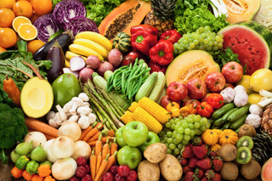
Genesis 1:29
“And God said, ‘See, I have given you every herb that yields seed which is on the face of all the earth, and every tree whose fruit yields seed; to you it shall be for food’.”

Slide 6
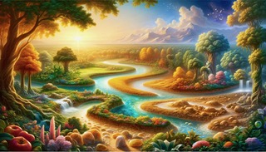
Genesis 2:8
The Lord God planted a garden eastward in Eden, and there He put the man whom He had formed.
Genesis 2:15
Then the Lord God took the man and put him in the garden of Eden to tend and keep it.

Slide 7

Genesis 2:18
And the Lord God said, “It is not good that man should be alone; I will make him a helper comparable to him.”

Slide 8
God is the Great Giver:
1. Life
2. Food
3. Home/dwelling place
4. Job/occupation
5. Companionship

Slide 9
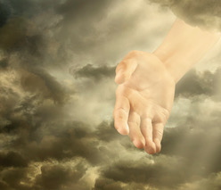
The first two chapters of the Bible portray
God as the Great Giver

Slide 10
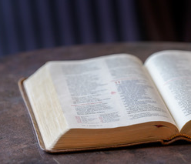
But in Genesis 3 we are introduced to the devil as the Great Taker

Slide 11
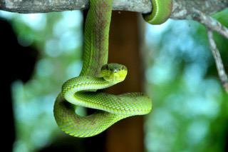
Genesis 3:1
Now the serpent was more cunning than any beast of the field which the Lord God had made. And he said to the woman, “Has God indeed said, ‘You shall not eat of every tree of the garden’?”

Slide 12
Genesis 3:2-4
And the woman said to the serpent, “We may eat the fruit of the trees of the garden; but of the fruit of the tree which is in the midst of the garden, God has said, ‘You shall not eat it, nor shall you touch it, lest you die.’ ” Then the serpent said to the woman, “You will not surely die. For God knows that in the day you eat of it your eyes will be opened, and you will be like God, knowing good and evil.”

Slide 13
Genesis 3:16
To the woman He said:
“I will greatly multiply your sorrow and your conception;
In pain you shall bring forth children;
Your desire shall be for your husband,
And he shall rule over you.”

Slide 14
Genesis 3:17
Then to Adam He said, “Because you have heeded the voice of your wife, and have eaten from the tree of which I commanded you, saying, ‘You shall not eat of it’:
“Cursed is the ground for your sake; In toil you shall eat of it all the days of your life.

Slide 15
Genesis 3:18-19
Both thorns and thistles it shall bring forth for you, and you shall eat the herb of the field. In the sweat of your face you shall eat bread till you return to the ground, for out of it you were taken; for dust you are, and to dust you shall return.”

Slide 16
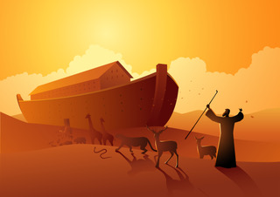
Genesis 6:5
Then the Lord saw that the wickedness of man was great in the earth, and that every intent of the thoughts of his heart was only evil continually.
So, when sin reigns supreme, what does God do? What does He give?
Genesis 6:8
But Noah found grace in the eyes of the Lord.

Slide 17
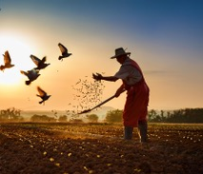
Jesus, speaking of what the devil does, says in
Luke 8:12
“Those by the wayside are the ones who hear; then the devil comes and takes away the word out of their hearts, lest they should believe and be saved.”

Slide 18
Genesis 12:2
I will make you a great nation;
I will bless you
And make your name great;
And you shall be a blessing.

Slide 19
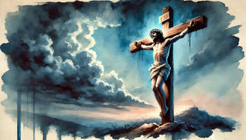
John 3:16
For God so loved the world that He gave His only begotten Son, that whoever believes in Him should not perish but have everlasting life.

Slide 20
Matthew 8:20
And Jesus said to him, “Foxes have holes and birds of the air have nests, but the Son of Man has nowhere to lay His head.”

Slide 21
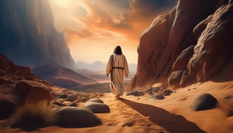
Matthew 4:3
Now when the tempter came to Him, he said, “If You are the Son of God, command that these stones become bread.”

Slide 22
Matthew 4:5-6
Then the devil took Him up into the holy city, set Him on the pinnacle of the temple, and said to Him, “If You are the Son of God, throw Yourself down. For it is written: ‘He shall give His angels charge over you,’ and, ‘In their hands they shall bear you up, lest you dash your foot against a stone.’

Slide 23
Matthew 4:8-9
Again, the devil took Him up on an exceedingly high mountain, and showed Him all the kingdoms of the world and their glory. And he said to Him, “All these things I will give You if You will fall down and worship me.”

Slide 24
Matthew 4:10
Then Jesus said to him, “Away with you, Satan! For it is written, ‘You shall worship the Lord your God, and Him only you shall serve.’ ”

Slide 25
Matthew 27:50
And Jesus cried out again with a loud voice, and yielded up His spirit.
John 19:30
So when Jesus had received the sour wine, He said, “It is finished!” And bowing His head, He gave up His spirit.

Slide 26
Romans 5:8
But God demonstrates His own love toward us, in that while we were still sinners, Christ died for us.

Slide 27
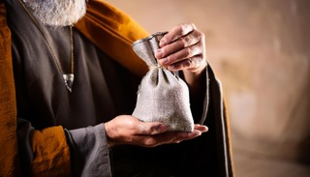
John 13:2
And supper being ended, the devil having already put it into the heart of Judas Iscariot, Simon’s son, to betray Him.

Slide 28
Hebrews 11

Slide 29

Matthew 25:23
‘Well done, good and faithful servant; you have been faithful over a few things, I will make you ruler over many things. Enter into the joy of your lord.’

Slide 30
the end

