Slide 1
Where Your Heart Belongs

Slide 2
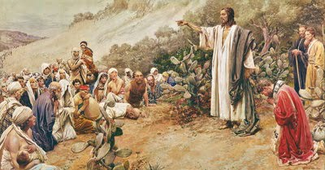
Sermon On The Mount
Seated with the disciples gathered around him on the shore of the Galilee Sea, Jesus delivered what we often refer to as the “Sermon on the Mount” (Matthew 5–7).

Slide 3
Sermon On The Mount
Jesus addresses a Christian’s:
character
influence
righteousness
piety
goals and priorities
relationships
commitment

Slide 4
Sermon On The Mount
Matthew 6:19–21 reads: “Do not lay up for yourselves treasures on earth, where moth and rust destroy and where thieves break in and steal; but lay up for yourselves treasures in heaven, where neither moth nor rust destroys and where thieves do not break in and steal. For where your treasure is, there your heart will be also.”

Slide 5
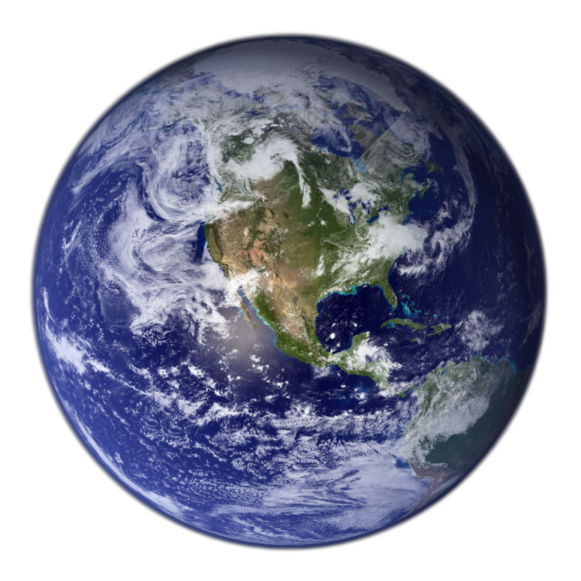
Moth, Rust, and Thieves
To help us understand why we should not store up treasures on earth, but in heaven, Jesus describes heaven and earth. He does so quite fascinatingly, in only three words:
moth
rust
thieves
Let’s take a closer look at each of these and see what they reveal.

Slide 6
Moth
Moths are tiny creatures that can create unwanted new patterns in your carpet, or turn your sweater into an unexpected piece of art.
The fact that Jesus spoke of the moth sparks curiosity about this somewhat evasive insect. What’s intriguing about moths is that it seems most species are pests.

Slide 7
Moth
They are agents of destruction for:
fruits and vegetables (our food)
trees (our environment)
clothes (our raiment)

Slide 8
Moth
What’s interesting about these facts was the breadth of harm Jesus grasped in just one word-moth.
Even years after Jesus chose the moth to describe destruction, we still understand what He had in mind.

Slide 9
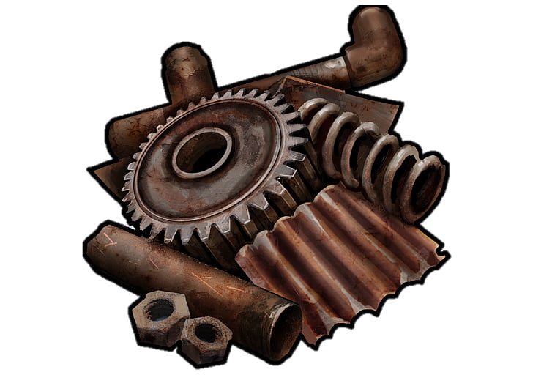
Rust
Jesus also refers to rust. Those living in northern climates are familiar with rust on cars. Car rust can be a problem but isn’t typically thought of in terms of disaster.

Slide 10
Rust
However, rust has the potential to create great peril, for example:
The story of the collapse of the Mianus River Bridge in Connecticut. On June 28, 1983, the bridge failed when the bearings rusted internally and pushed one corner of the road slab off its support.

Slide 11
Rust
Another example:
The Silver Bridge disaster of 1967 in West Virginia, when a steel suspension bridge collapsed in less than a minute. Forty-six people lost their life due to rust in a single link.

Slide 12
Rust
Rust can also be a plant disease affecting leaves, stems, fruits, and seeds. Plant rusts are parasites and require a living host, such as a plant, to complete their life cycle. Cereal crops can be devastated in one season, and trees often die due to this.

Slide 13
Rust
Art and literature describe rust has as a metaphor for ruin, decay, and faded glory. Jesus’ use of the word makes no exception. Rust and moths can affect means of transportation, food, environment, and clothes. Aspects that cover a significant part of our lives.

Slide 14
Thieves
A thief is a person who steals another person's property, especially stealthily or secretly. Although condemned in the Bible and prohibited by law, stealing has infested our world with much loss and grief, generating an atmosphere of insecurity and anxiety.

Slide 15
Thieves
Stealing takes place in different ways, at various levels, and with a diverse range of targets.
Individuals, organizations, governments, and nations can steal.

Slide 16
Thieves
What Can Be Stolen?
Material goods and intellectual property
Identity
Significant Other (Adultery)
Time and effort
Talent
Someone else’s present and future

Slide 17
Selfishness
In one word, the one concept Jesus chose to illustrate the human decay, is broad and easily understood. The word describes the condition of the entire human race — selfishness.
Selfishness is what stands at the foundation of sin.

Slide 18
Selfishness
Lucifer wanted to steal God’s throne. Eve and Adam stole each other’s innocence, robbed all their descendants of God’s presence and peace of a sinless heart.
Selfishness has marked and driven the course of human beings who are bound for decay and, eventually, complete destruction.

Slide 19
What Is Earth Like?
Jesus’ words are remarkably rich in content and meaning. They are a carefully crafted summary of all evil on earth. Natural and moral evil are terms that generally describe two types of evil.
Natural evil refers to evil in the material and animal world not caused by human beings.
Moral evil describes the evil caused by humans.

Slide 20
What Is Earth Like?
In Matthew 6:19, 20, Jesus encompasses the reality of all evil through three words that represent the three types of evil on earth:
Moth: representing animal natural evil
Rust: representing material natural evil
Thieves: representing human moral evil

Slide 21
What Is Earth Like?
In three words, He clearly sums up the condition of our planet with all it contains and illustrates the heart of His teaching: earthly life is marked by instability and insecurities and saturated with the pain of loss and separation.
Yet, this passage reveals not only the decay characteristic of our fallen planet, but also a solution, an alternative to perishing.

Slide 22
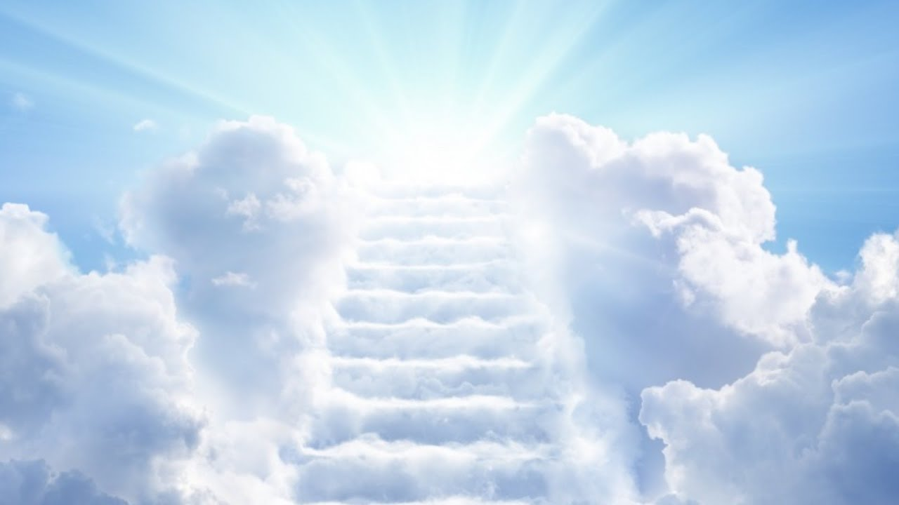
What Is Heaven Like?
As One who came down from heaven, the Son of God goes on to weave hope into the reality of the world He just depicted. It is now time to lift our eyes towards the land of the redeemed.
Even among Christians who read the Bible, there are various ideas about what heaven is like. Let’s see what kind of heaven this biblical passage reveals to us:

Slide 23
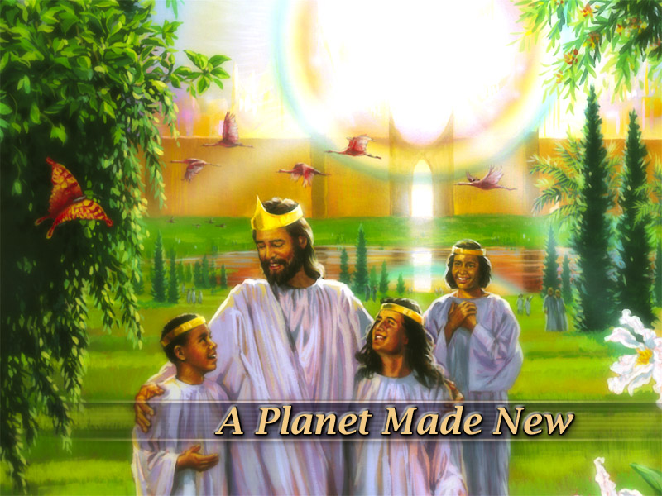
What Is Heaven Like?
1. Heaven, like earth, is real and yet distinct from earth.
Heaven is the name for something that is actually real and distinct from earth.
What we refer as heaven, it is really a new earth.

Slide 24
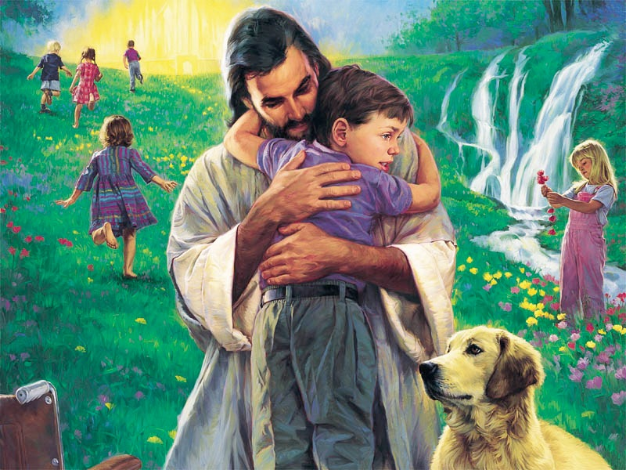
What Is Heaven Like?
2. Evil - natural or moral - will not exist in heaven; therefore, no loss.
On earth everything is unstable, uncertain, and insecure; it is subject to decay, destruction, stealing, and loss. Heaven is the opposite: everything is eternal, durable, secure, and imperishable.
There will be NO more children on wheelchairs

Slide 25
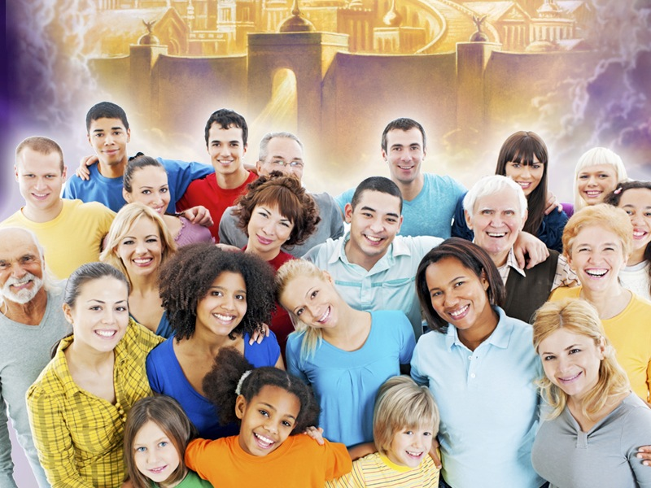
What Is Heaven Like?
3. Heaven is something we should wish for.
Jesus invites us to lay up treasures for ourselves in heaven. Heaven is something we should wish for, and only we can choose for ourselves. It is not something we can give up so others can have it; Jesus made provision for everyone who desires it.

Slide 26
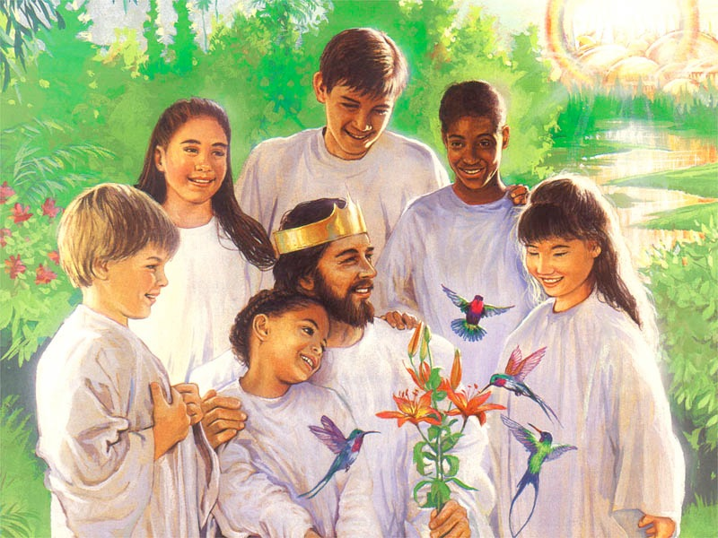
What Is Heaven Like?
4. Heaven is possible to obtain.
The happiest part in all of what Jesus is saying is that we can have part in this reward. We can not only wish to be there, but we can plan to be there.

Slide 27
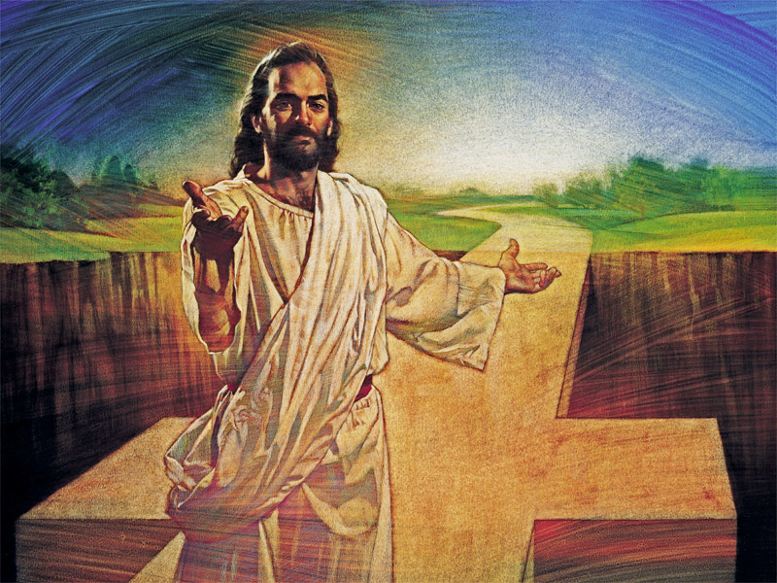
What Is Heaven Like?
4. Heaven is possible to obtain.
The very One whose hands and feet were pierced with iron nails, invites us to lay up treasures there; even while living on earth we can partake of heaven.

Slide 28
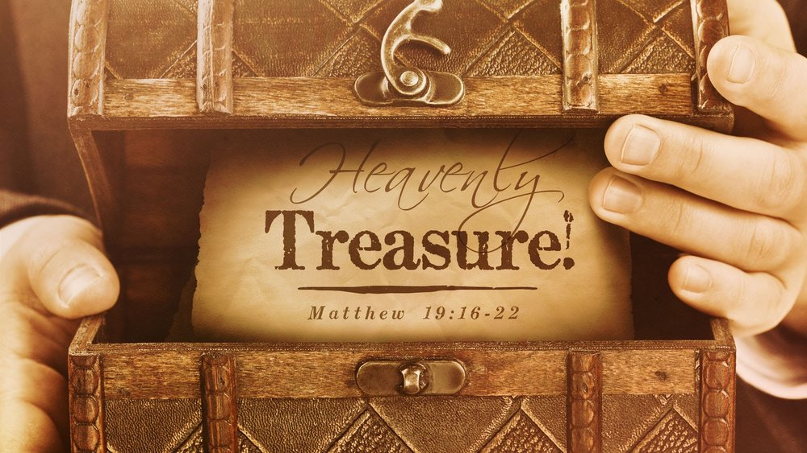
Heavenly Treasure
But how are we to gather treasures in heaven?
We cannot fly there to lay up gold or goods, and we don’t have a bank of heaven. R. T. France reminds us that heavenly treasures are “stored up not by my performing meritorious acts, but by belonging to and living by the priorities of the kingdom of heaven.”

Slide 29
Heavenly Treasure
Ellen White in book Christian Service, 221 tells us what “heavenly treasure” means:
"Every opportunity to help a brother in need, or to aid the cause of God in the spread of the truth, is a pearl that you can send beforehand, and deposit in the bank of heaven for safe keeping.”

Slide 30
Heavenly Treasure
She also writes in Counsels on Stewardship, 116: “What shall we do with our time, our understanding, our possessions, which are not ours, but are entrusted to us to test our honesty? Let us bring them to Jesus. Let us use our treasures for the advancement of His cause. Thus, we shall obey the injunction, ‘Lay not up for yourselves treasures upon earth, . . . but lay up for yourselves treasures in heaven.’

Slide 31
Heavenly Treasure
Some people may suggest Jesus’ words in Matthew 6 speak against wealth and well-being. The text, however, does not indicate a requirement for us to live in poverty.
Rather, the word treasure in this context implies gathering, storing up wealth. It suggests a way to create security for ourselves by relying on our own powers and resources.

Slide 32
Heavenly Treasure
Is only when we place our treasures in heaven, that we are NOT “possessed by our possessions”.

Slide 33
Heavenly Treasure
When Jesus tells us to store our treasures in heaven, He is inviting us to walk through this life as people who understand that this world is not our home. That our true home is in heaven.

Slide 34
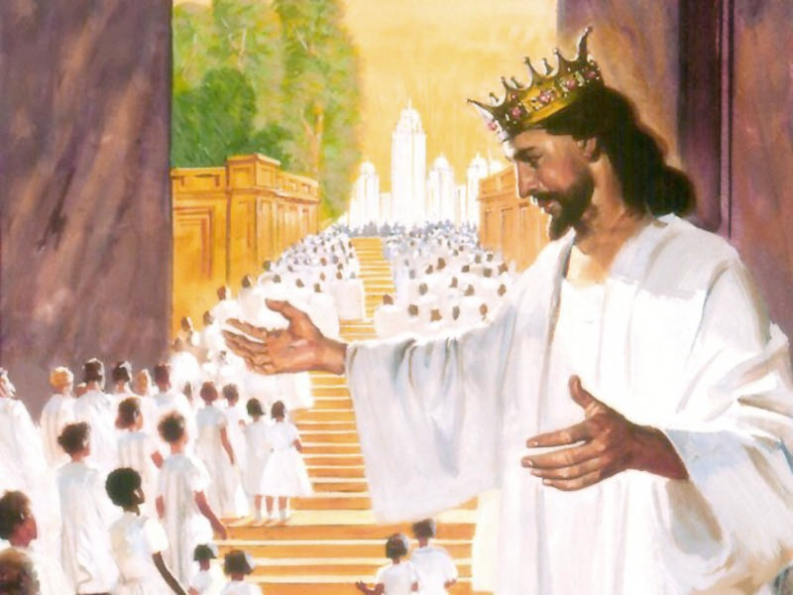
Conclusion
Perhaps you think you are not worthy of heaven; you’ve been wandering away from God, and heaven sounds like a place someone like you could not attain.

Slide 35
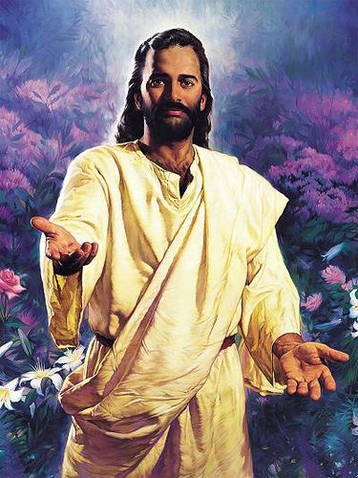
Conclusion
Today, Jesus is calling you home. Jesus is calling you back. He wants to transform you and wants you to accept the promise of heaven. You are a son and daughter of God, and you belong in heaven.

Slide 36
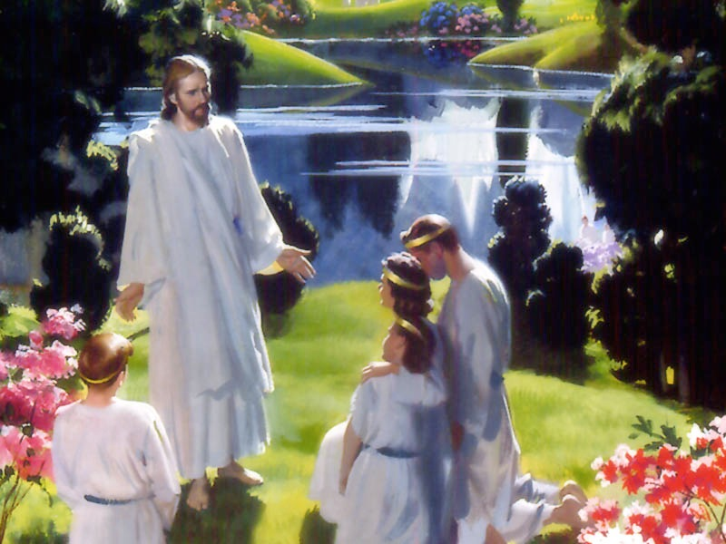
Conclusion
Lift your eyes to the sky, breathe in the freshness of this very moment of life, and may you be reminded that heaven is a place of reunion, healing, and peace.
Don’t lose faith
Don’t lose sight
Don’t lose heart

Slide 37
Conclusion
Jesus, is inviting you to store your treasures in heaven because... “For where your treasure is, there your heart will be also.”

Slide 38
THE END

