Slide 1
“Knowledege, Commitment, and Transformation-
The Making of a Faithful Steward”
By Domingo Paulino

Slide 2
Calls to faithful
stewardship bring:
-personal blessings increase
-tithes & offerings increase
-Church needs are met
-Morale is high
-Projects are completed
-Financial reports are encouraging
-Future looks bright
Image by Pabitra Kaity from Pixabay

Slide 3
But sometimes…
People are not faithful:
-pledges are broken
-tithes & offerings are down
-morale is low
And sometimes the situation is worse because you added: GUILT
Image by mohamed Hassan from Pixabay

Slide 4
The Problem is not:
-Lack of communication
-Lack of enthusiasm
-Absence of sincerity or honesty
Image by Gerd Altmann from Pixabay

Slide 5
The reason why people break their promises and vows is:
DISCIPLINE
Image by Ricarda Mölck from Pixabay

Slide 6
We don’t learn
Discipline by:
-attending a seminar
-listening to a sermon
-making another commitment
-or by making another vow.
Image by Fer Galindo from Pixabay

Slide 7
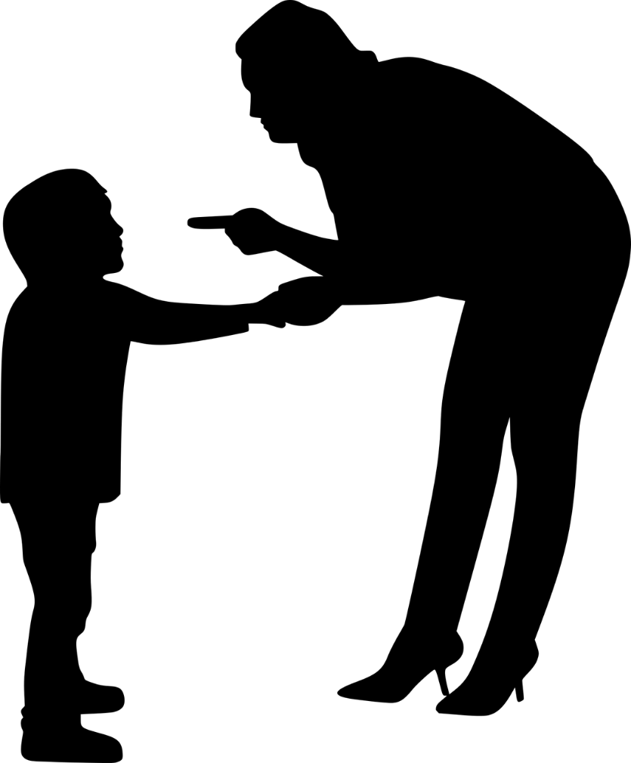
Discipline takes time-
It is a learning process
Image by mohamed Hassan from Pixabay

Slide 8
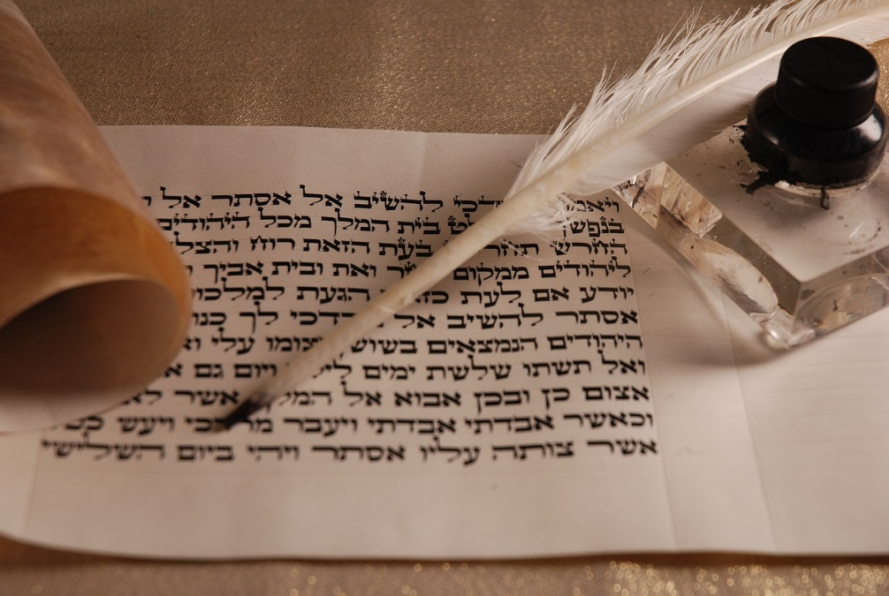
Let’s learn about discipline from the
Nazirite Vow in Numbers 6
Image by zofiaEliyahu from Pixabay

Slide 9
Numbers 6:2
Speak to the children of Israel, and say to them: ‘When either a man or woman consecrates an offering to take the vow of a Nazirite, to separate himself to the Lord,

Slide 10
Numbers 6:3
he shall separate himself from wine and similar drink; he shall drink neither vinegar made from wine nor vinegar made from similar drink; neither shall he drink any grape juice, nor eat fresh grapes or raisins.

Slide 11
Numbers 6:4
All the days of his separation he shall eat nothing that is produced by the grapevine, from seed to skin.

Slide 12
Numbers 6:5
All the days of the vow of his separation no razor shall come upon his head; until the days are fulfilled for which he separated himself to the Lord, he shall be holy. Then he shall let the locks of the hair of his head grow.

Slide 13
Numbers 6:6-7
All the days that he separates himself to the Lord he shall not go near a dead body. He shall not make himself unclean even for his father or his mother, for his brother or his sister, when they die, because his separation to God is on his head. All the days of his separation he shall be holy to the Lord.

Slide 14
3 things that were part of the Nazirite Vow so a person would be separate and be holy to the Lord:
Don’t eat anything from
the fruit of the vine
Don’t cut the hair
Don’t touch a dead body
Image by 13smok from Pixabay

Slide 15
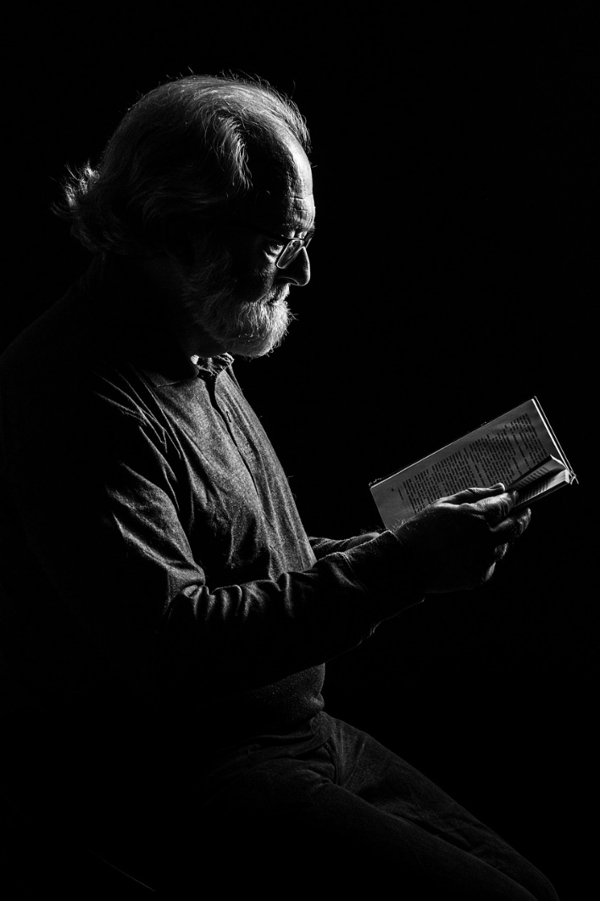
3 aspects of
Stewardship
That were part
Of the Nazirite Vow:
Knowledge
Commitment
Transformation
Image by Erich Röthlisberger from Pixabay

Slide 16
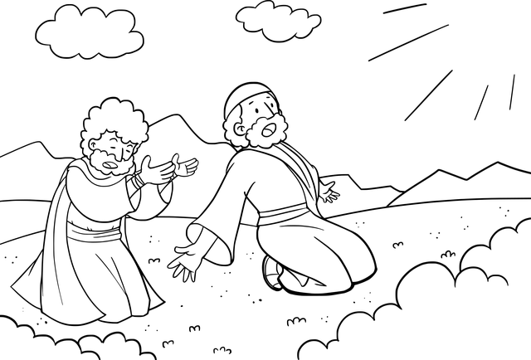
God Called Abraham
and his descendants
to be His people
Image by CCXpistiavos from Pixabay

Slide 17
Exodus 19:3-6
And Moses went up to God, and the Lord called to him from the mountain, saying, “Thus you shall say to the house of Jacob, and tell the children of Israel: ‘You have seen what I did to the Egyptians, and how I bore you on eagles’ wings and brought you to Myself. Now therefore, if you will indeed obey My voice and keep My covenant, then you shall be a special treasure to Me above all people; for all the earth is Mine. And you shall be to Me a kingdom of priests and a holy nation.’

Slide 18
God Called His people
To Holiness.
But it is a personal choice just like the Nazirite vow.

Slide 19
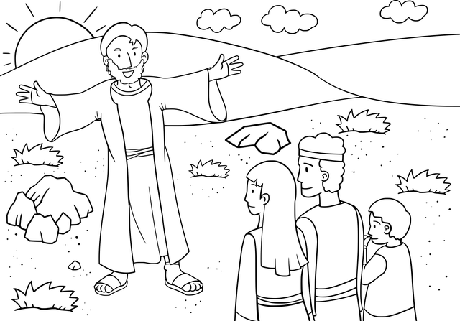
Joshua 24:15
“…But as for me and my house, we will serve the Lord.”
Image by CCXpistiavos from Pixabay

Slide 20
1 Kings 19:18
“Yet I have reserved seven thousand in Israel, all whose knees have not bowed to Baal, and every mouth that has not kissed him.”

Slide 21
We are called to be holy even if other people are breaking their vows.
Image by mohamed Hassan from Pixabay

Slide 22
1 Peter 2:9
“But you are a chosen generation, a royal priesthood, a holy nation, His own special people, that you may proclaim the praises of Him who called you out of darkness into His marvelous light.”

Slide 23
Why do we have to sign so many documents when taking a loan?
Lack of Commitment from many people.
Image by Juan Ospina from Pixabay

Slide 24
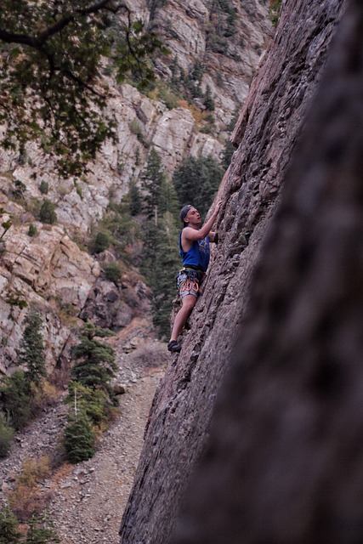
Commitment
The person who took the Nazirite vow not only had the knowledge, but also had the willingness to sacrifice.
Image by spencer Ford from Pixabay

Slide 25
Matthew 6:24
No man can serve two masters: for either he will hate the one, and love the other; or else he will hold to the one, and despise the other. Ye cannot serve God and mammon.

Slide 26
Matthew 6:33
Seek ye first the kingdom of God, and his righteousness; and all these things shall be added unto you.

Slide 27
The person who took the Nazirite vow made a commitment to put God first and above everything and everyone.
Image by Barbara Jackson from Pixabay

Slide 28
How do you exercise that kind of commitment?
Set aside specific time exclusively for God.
Adopt a lifestyle characterize by total abstinence of bad things.
Remember specific events that helped you renew your commitment .

Slide 29
What is the outcome of knowledge and commitment to a vow?
Transformation

Slide 30
Numbers 6:6-7
All the days that he separates himself to the Lord he shall not go near a dead body. He shall not make himself unclean even for his father or his mother, for his brother or his sister, when they die, because his separation to God is on his head.

Slide 31
This was emotionally difficult to fulfill but the individuals who took the vow did it.
Question:
What was the basis for this behavior? LOVE

Slide 32
Deuteronomy 6:5
“And you shall love the Lord your God with all thine heart, and with all your soul, and with all your might”

Slide 33
Their comfort came from God
and not from participating in the funeral of a loved one.
Image by Anja-#pray for ukraine# #helping hands# stop the war from Pixabay

Slide 34
Matthew 10:37
“He who loves father or mother more than Me is not worthy of Me. And he who loves son or daughter more than Me, is not worthy of Me”

Slide 35
A deep love for God is the motivation for our commitment.
Image by StockSnap from Pixabay

Slide 36
1 Corinthians 5:14
“For the love of Christ compels us.”

Slide 37
The Nazirite was not asked to practice moderation, but rather abstinence.
Image by Gordon Johnson from Pixabay

Slide 38
The result of abstinence (total food fast) was transformational.
When a person fasts for religious reasons, God changes a person from within.

Slide 39
Mark 9:29
“This kind can come out by nothing but prayer and fasting.”

Slide 40
Total food fast
is key
to experience transformation

Slide 41
Someone could not uphold the Nazirite vow and keep it hidden from family and friends.
Image by mohamed Hassan from Pixabay

Slide 42
Even Olympic Athletes
have to make lifestyle changes if they want to win a gold medal
Image by Clker-Free-Vector-Images from Pixabay

Slide 43
1 Corinthians 9:25
“And everyone who competes for the prize is temperate in all things. Now they do it to obtain a perishable crown, but we for an imperishable crown.”

Slide 44
Transformation requires commitment
Image by mohamed Hassan from Pixabay

Slide 45
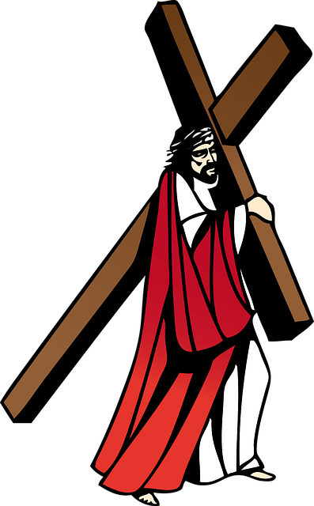
Jesus is the best example of commitment
Image by OpenClipart-Vectors from Pixabay

Slide 46
“The Scriptures say: No one can live only on food. People need every word that God has spoken” (Matthew 4:4, CEV).

Slide 47
“The Scriptures also say, ‘Don’t try to test the Lord your God!’ ” (Matthew 4:7, CEV).

Slide 48
“Go away Satan! The Scriptures say: ‘Worship the Lord your God and serve only him’ ” (Matthew 4:10, CEV).

Slide 49
Conclusion
Faithful stewards are not individuals who try harder—faithful stewards are individuals whose lives have been transformed

Slide 50
Conclusion
*Transformation enables us to practice radical stewardship in our lives.
*We become God’s disciplined stewards on this earth.

