Slide 1


Slide 3
Revolutionary Generosity
Sermon Series
RG Message:
“Revolutionary Generosity”
Elder Michael A. Harpe
North American Division, Stewardship Director

Slide 5


“For where your treasure is, there your heart will be also,”
Matthew 6:21 NKJV

Slide 6

Stewardship is
…a matter of the Soul.

Slide 8
What is
Stewardship?

Slide 9
“
Stewardship is first and foremost about our relationship with God.
—Michael Harpe

Slide 10
Stewardship is not transactional
About Money Only

Slide 11
Stewardship is
transformational
Wholistic: Balanced Salvific

Slide 12
What is Stewardship?
Wholistically it is
Life Management
in every area
Whole

Slide 14
Sermon Title:
Revolutionary Generosity!

Slide 15

Let Us Pray!

Slide 16
REVOLUTIONARY GENEROSITY
“It’s not just about money”
Matthew 6:19-34

Slide 17
Revolutionary Generosity
Definitions

Slide 18
“REVOLUTION”
A complete and forcible overthrow and replacement of an established system
A sudden, complete, or radical change in something

Slide 19
“REVOLT”
To break away from or use against
To refuse to accept or be subjected to some condition

Slide 20
“REVOLUTIONARY GENEROSITY”
“Is the breaking away from and overthrow of a lifestyle that is centered on accumulation and self absorption.”
“It is rising against the falsely created insatiable need for more and refusing to be subjected to the fear of not having enough to be truly happy.”

Slide 21
Revolutionary Generosity
There is a vast difference between habit and happenstance. One is focused, the other is fuzzy.
The Bible does not call us to live out our faith randomly, but to live it deliberately.
-John C. Maxwell

Slide 22
Revolutionary Generosity
Jesus was not random In His practice of generosity.
He was Intentional, focused and purposeful-just as we should be.
-John C. Maxwell

Slide 23
Revolutionary Generosity
I. Revolutionary Generosity demands that we make a change in our perspective. That we gain a fresh vision of the nature of generosity: how it acts, looks, and feels in the context of our current reality.

Slide 24
Revolutionary Generosity
How Generosity Acts, Looks, and Feels
Our Current Reality

Slide 25
Revolutionary Generosity
means being
Interactive Christians
Notes:
25

Slide 26
Revolutionary Generosity
How Generosity Acts, Looks, and Feels
Our Current Reality

Slide 27
Revolutionary Generosity
How Generosity Acts, Looks, and Feels
Our Current Reality
“WWJD?”

Slide 28
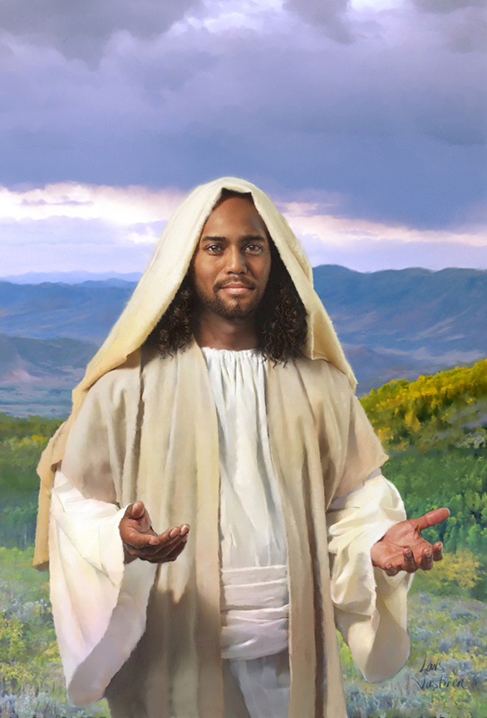
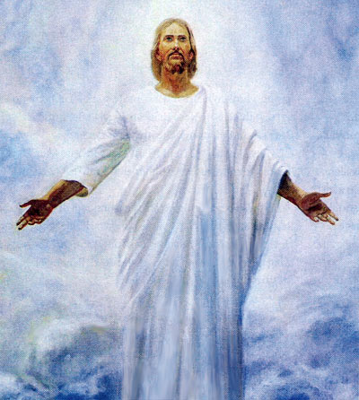

Slide 30
Revolutionary Generosity
How Generosity Acts, Looks, and Feels
Our Current Reality
“WWJD?”

Slide 31
Revolutionary Generosity
II. …is Trusting God’s Sovereignty & Ownership

Slide 32
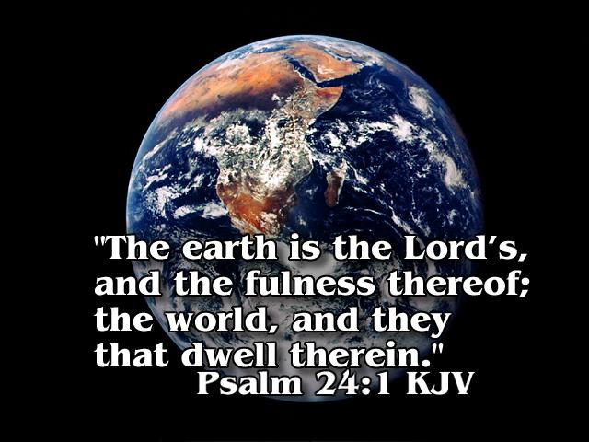

Slide 33

Let’s turn to Matt. 6:25-33
Notes:
33

Slide 34
Revolutionary Generosity
II. …is Trusting God’s Sovereignty & Ownership
Matt. 6:25 Therefore I say unto you, Take no thought for your life, what ye shall eat, or what ye shall drink; nor yet for your body, what ye shall put on. Is not the life more than meat, and the body than raiment?

Slide 35
Revolutionary Generosity
II. …is Trusting God’s Sovereignty & Ownership
Matt. 6:30 Wherefore, if God so clothe the grass of the field, which to day is, and tomorrow is cast into the oven, shall he not much more clothe you, O ye of little faith?

Slide 36
Revolutionary Generosity
II. …is Trusting God’s Sovereignty & Ownership
Matt. 6:31 Therefore take no thought, saying, What shall we eat? or, What shall we drink? or, Wherewithal shall we be clothed?

Slide 37
Revolutionary Generosity
II. …is Trusting God’s Sovereignty & Ownership
Matt. 6:32 (For after all these things do the Gentiles seek:) for your heavenly Father knoweth that ye have need of all these things.

Slide 38
Revolutionary Generosity
II. …is Trusting God’s Sovereignty & Ownership
Matt. 6:33 But seek ye first the kingdom of God, and his righteousness; and all these things shall be added unto you.

Slide 39
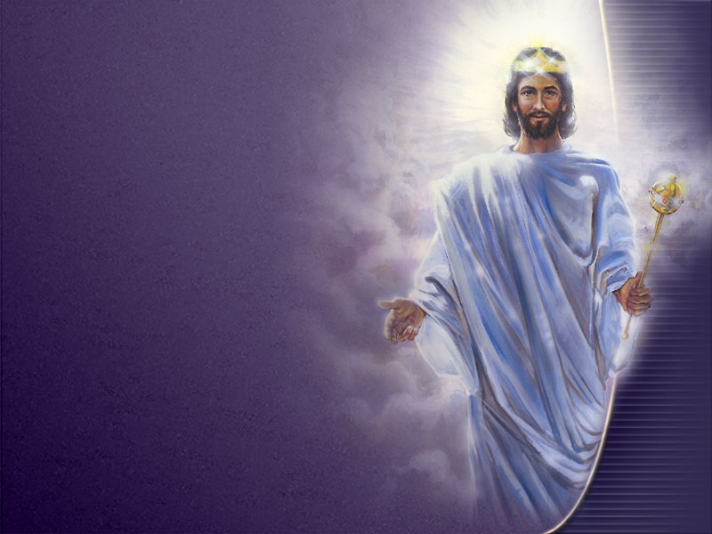
How do we Acknowledge God's Sovereignty & Ownership?

Slide 40
We must manage with all our might the gifts he has given in this life.

Slide 41
Life can be divided into Seven basic areas, each a gift from God.

Slide 42


Revolutionary Generosity
T7 Concept (T⁷)
{
Seal
{
Whole Armor of Light-Jesus
4 Pillars
Tangible T’s
Time
Temple
Talent
Treasure
{
Trust in God
3 Bedrock
Foundational T’s
Theology
Testimony
The “ROCK” Jesus

Slide 43
Revolutionary Generosity
III. How Generosity Acts, Looks, and Feels may also be seen in the way we manage God’s goods:
Time, Temple, Talent, and Treasure (Tangible T’s from T7 Concept).

Slide 44
T1 - Time

Slide 45
If ye LOVE Me, keep my Commandments. John 14:15

Slide 46
Love Formula
(Love God)
+
(Love Your Neighbor)
(1) First 4 Commandments Represent our responsibility to God
Matt. 22:37, 38
(+1) Last 6 Commandments Represent our responsibility to Mankind
Matt. 22:39, 40

Slide 47
Love Formula
(Love God)
+
(Love Your Neighbor)
=
Living out the Word of God
with God Each Day

Slide 49
T1 - Time
Let us plan Early, Time, Quality Time, Alone Time with the Master.
Think of it this way: Before we can have financial peace, we must first seek personal peace daily with the Master.

Slide 50
T1-Time: God Must Be First!
But seek ye first the kingdom of God, and his righteousness; and all these things shall be added unto you. Matt. 6:33

Slide 51
T2 - Temple

Slide 52
What? know ye not that your body is the temple of the Holy Ghost which is in you, which ye have of God, and ye are not your own?
(1 Corinthians 6:19)

Slide 53
For ye are bought with a price: therefore glorify God in your body, and in your spirit, which are God’s. (I Corinthians 16:20)

Slide 54
A good steward will follow a daily health plan for the improvement of life and practice consistently the eight natural laws of health--

Slide 55
NEW
Nutrition
Exercise
Water
START
Sunshine
Temperance
Air
Rest
Trust
(in Divine Power)

Slide 56
T3 - Talent

Slide 57
Talents & Gifts
God Gives Gifts to His Family (Us)

Slide 58
T3 - Talents
…We are stewards, supplied from God with talents and facilities [abilities] and placed in the world to do a work appointed by Him. Education, 137 – (AH 367.2)

Slide 59
T3 - Talents
The talents that Christ entrusts to His church represent especially the gifts and blessings imparted by the Holy Spirit. (COL 327)

Slide 60
T3 - Talents
In becoming His disciples, we surrender ourselves to Him with all that we are and have. These gifts He returns to us purified and ennobled, to be used for His glory in blessing our fellow men,” (COL 328)

Slide 61
God Must Be First!
T4 - Treasure

Slide 62
The Power to RETURN & GIVE
Stewards will return tithe, the whole tenth, for the world work, and give a liberal offering to support the local church’s mission to the community.

Slide 63
The Power to RETURN & GIVE
A good steward will also learn and practice debt-free living. Getting out of debt is essential to being free from financial enslavement.

Slide 64
In addition, we must care for the world around us, over which we were given dominion. This takes dedication and true Heart Commitment.

Slide 65
We must Give ALL -What is all?
T4 Concept or T⁴ = TxTxTxT
= ALL —it’s a Lifestyle
—It’s our All
We must give, Time, Temple, Talent, and Treasure to Jesus.
Give it all to Jesus…
—this is truly worship!

Slide 67

Generosity is
the Heart of Stewardship

Slide 68

Let us start a Revolution,
a complete Revolution of Generosity!

Slide 69
Revolutionary Generosity
IV. Revolutionary Generosity must be lived out far beyond self-interest and desired outcomes

Slide 71
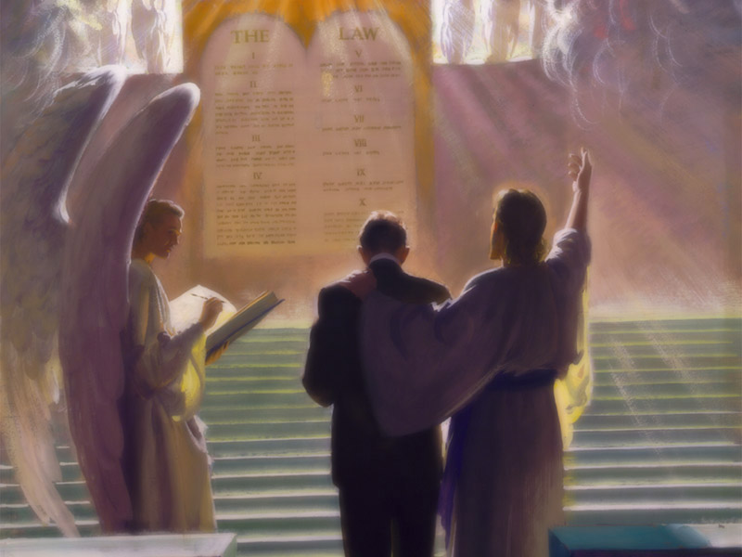
As we “live out” the Gospel, we can be certain from Scripture that we must ALL someday stand before the judgment seat of God.
(See 2 Cor. 5:10)

Slide 72
Christians are not worried about the Judgment.
We know that Jesus Christ is the Judge!

Slide 73
He will never lose any case entrusted to Him.
The questions are these:
Is my case in Jesus' hands? Have I given my case to Him?

Slide 74
Therefore
THE JUDGMENT
IS
GOOD NEWS!

Slide 75
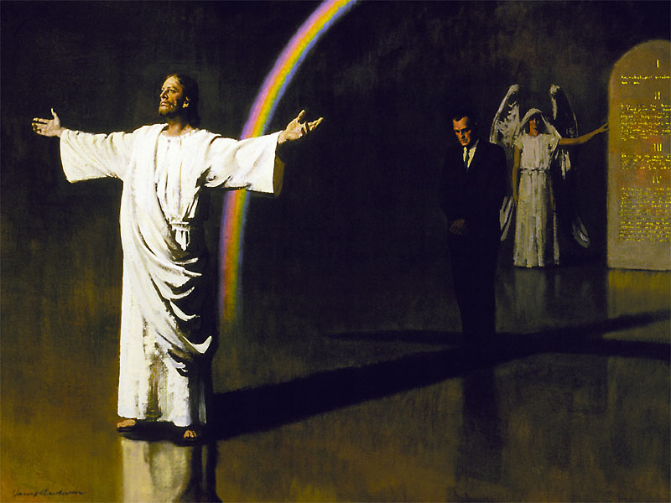
Revolutionary Generosity
Stewardship & Prophecy
Let’s look at an important point related to the judgment in the parable of the Talents found in Matt. 25

Slide 76
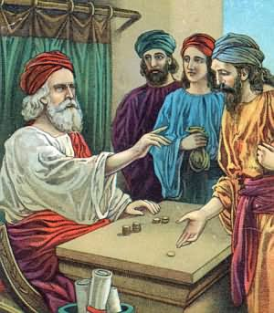
Here’s the important point: “After a long time the lord of those servants came and settled accounts with them.”
Matthew 25:19--
The Investigative Judgement!
How did you do with My Stuff?
(I left you in charge of it.)

Slide 78
“REVOLUTIONARY GENEROSITY”
“Is the breaking away from and overthrow of a lifestyle that is centered on accumulation and self absorption.”
“It is rising against the falsely created insatiable need for more and refusing to be subjected to the fear of not having enough to be truly happy.”

Slide 79
A Perspective on Giving
“Every man according as he purposeth in his heart, [so let him (her) give]; not grudgingly (reluctantly-NIV), or of necessity (compulsion-NIV): for God loveth a cheerful giver.” 2 Corinthians 9:7 KJV

Slide 80
A Perspective on Giving
This verse of Scripture means more than money. When I give my time, temple, talent, and treasure, (Tangible T’s) it should be “not grudgingly (reluctantly-NIV), or of necessity (compulsion-NIV),” but with a cheerful willing heart.

Slide 81
God Loves a Cheerful Giver!
God loves-Jn. 3:16
A cheerful giver-Relationship
How do I become a CHEERFUL Giver?
A personal devotional life first in priority is a matter of the heart; it helps me build my love relationship with Jesus daily, this is PERSONAL PEACE!
His peace in me passeth all understanding; it helps me to be CHEERFUL knowing how much God means to me; I owe Him my all.
Giving then becomes a matter close to my heart.
I will garner strength from Him to manage my life according to His plan and be His good steward.

Slide 82
In Conclusion
Revolutionary Generosity…
demands that we change our perspective. We must gain a fresh vision of the nature of generosity: how it acts, looks, and feels in the context of our current reality.
demands WDWJD (we do what Jesus did) Jesus kept putting the unlike-ables at the head of the table.
must be lived out far beyond self-interest and desired outcomes

Slide 83
Revolutionary Generosity
With Jesus, generosity can become a habit, not happenstance.
We must ask God to help us produce extraordinary acts of generosity to meet extraordinary challenges.

Slide 84
Revolutionary Generosity Appeal
Are you willing to be a Revolutionary?
Are you willing to live out the Gospel generously in all areas of your life?
Ask God to speak to you now and in the coming weeks about the generosity in your heart and life. In doing so, be ready, He will speak.

Slide 85
To experience and share true
Revolutionary Generosity
we must trust Him fully! Will You?

Slide 86
REVOLUTIONARY GENEROSITY
“It’s not just about money”
Matthew 6:19-34

