Slide 1
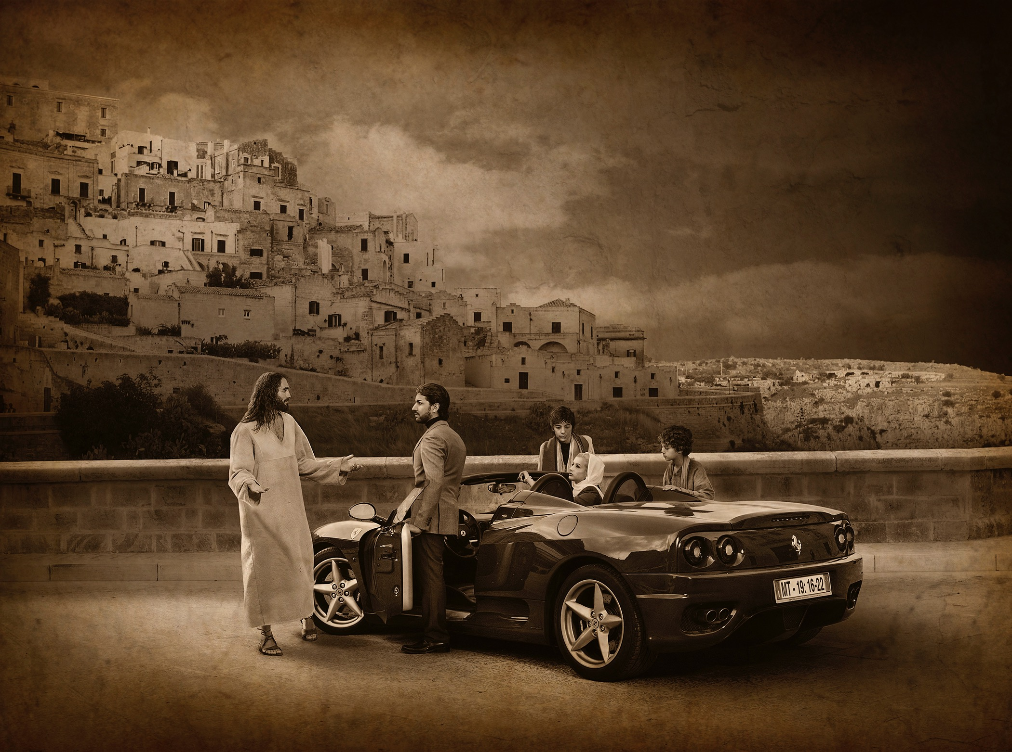
THE ECONOMICS OF ENOUGH
Faith-Vs-Finance.org
See more incredible images at www.journeyswiththemessiah.org

Slide 3
When you finally get all you want, will it be enough?
www.Faith-vs-Finance.org

Slide 4
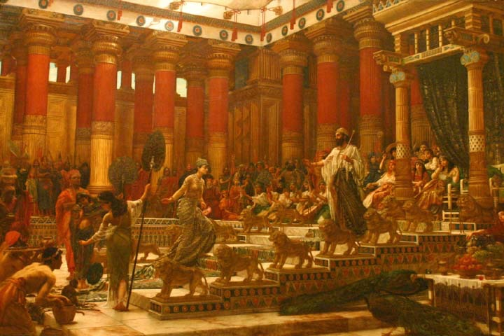
“I became greater by far than anyone in Jerusalem before me.” Ecclesiastes 2:11

Slide 5
“He who loves money never has money enough; whoever loves wealth is never satisfied with his income.” Ecclesiastes 5:10
www.Faith-vs-Finance.org

Slide 6
SKIPPING STONES VIDEO

Slide 7
What has been the impact of 25 years of uninterrupted economic growth?
The Land of Plenty
www.Faith-vs-Finance.org

Slide 8
Christian churches drifting too far from the marketplace of ideas
Greg Sheridan, 4 June 2016, The Australian
“In Western Europe, on the east and west coasts
of the US, and in Australia, the new religion of
aggressive secularism is on the rise, more self-confident and fundamentalist than ever.
Widespread, prolonged affluence has been more effective than oppression ever was in killing religious belief and practice. To take one figure almost at random, in 1954, 74 per cent of Australian Cath­olics attended mass each Sunday. Today the figure is substantially less than 10 per cent.
The churches cannot recognise and come to grips with their strategic circumstances. They behave as though they still represent a living social consensus.”
www.Faith-vs-Finance.org

Slide 9
Christian churches drifting too far from the marketplace of ideas
Greg Sheridan, 4 June 2016, The Australian
“The real danger now is the increasingly
frequent direct attacks on religious freedoms. …
The aggressive secularism of public culture has become increasingly a state religion in itself and will use the coercive powers of the state to enforce its new orthodoxy.
Soon, apparently, it will be positively illegal for Christian churches to publish their traditional teachings. The intolerance of Australia’s secular religion, which adds to legal harassment the effective tactic of ridicule and endless public abuse, is evident. Will Christian schools be allowed to teach their traditional beliefs?”
won’t want
www.Faith-vs-Finance.org

Slide 10
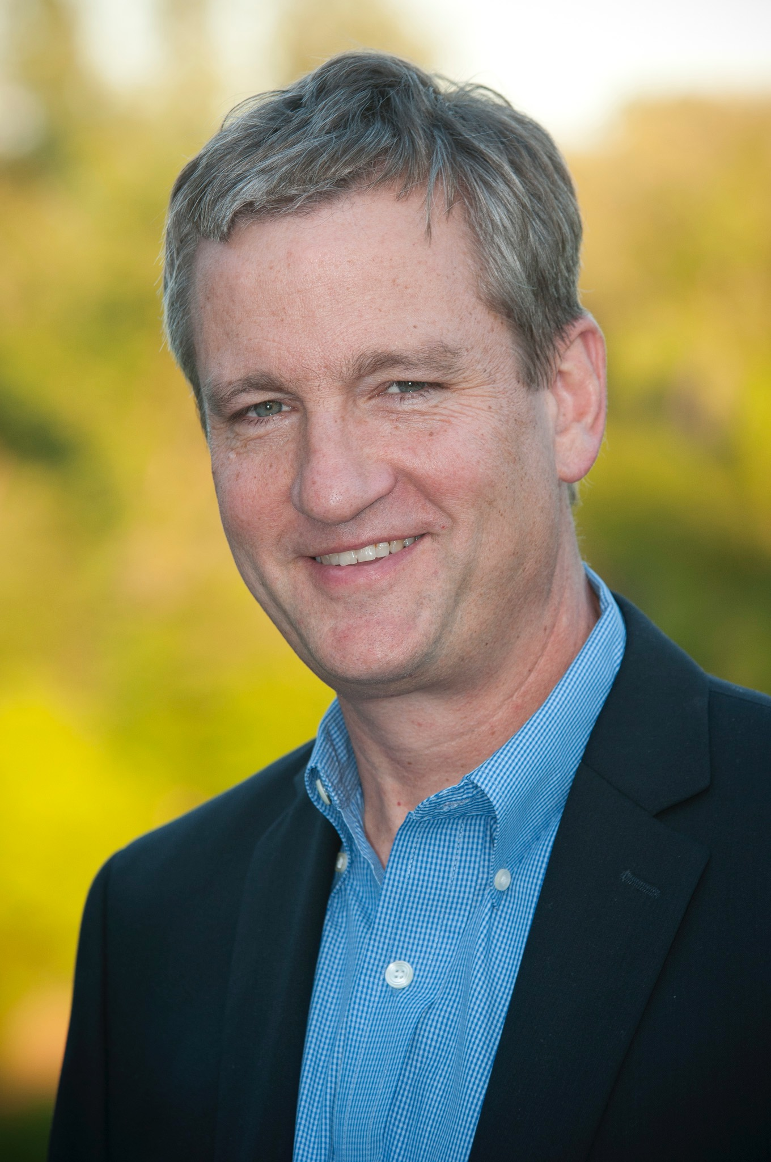
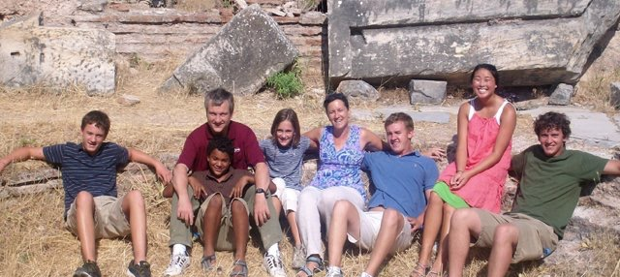

Slide 11
“The army camp cooks shouldn’t eat any better than the soldiers on the front line.”
Alan Barnhart
CEO Barnhart Cranes & Rigging
www.Faith-vs-Finance.org

Slide 12
Could it be true?
God blesses us beyond
our needs so we can improve our standard of GIVING,
not our standard of LIVING.

Slide 14
“Money is like manure.
Pile it up and it stinks.
But spread it around and
it does a lot of good.”
Clint Murchison Jnr

Slide 15
WARNING! Personal Beliefs Ahead!

Slide 16
What does the Bible say about retirement?

Slide 17
“Then the Lord spoke to Moses, saying, “This is what pertains to the Levites: From twenty-five years old and above one may enter to perform service in the work of the tabernacle of meeting; and at the age of fifty years they must cease performing this work, and shall work no more. They may minister with their brethren in the tabernacle of meeting, to attend to needs, but they themselves shall do no work. Thus you shall do to the Levites regarding their duties.””
Numbers 8:23-26

Slide 18
“Therefore I say to you, do not worry about your life, … Therefore do not worry, saying, ‘What shall we eat?’ or ‘What shall we drink?’ or ‘What shall we wear?’ For after all these things the Gentiles seek. For your heavenly Father knows that you need all these things. But seek first the kingdom of God and His righteousness, and all these things shall be added unto you. Therefore do not worry about tomorrow, for tomorrow will worry about its own things.”
Matthew 6:25, 31-34

Slide 19
Could it be?
The reward for good work is more work, not retirement.

Slide 20
“I have fought the good fight, I have finished the race, I have kept the faith.”
2 Timothy 4:7
www.Faith-vs-Finance.org

Slide 21
“God, You have taught me from my youth; And to this day I declare Your wondrous works.
Now also when I am old and grey-headed, O God, do not forsake me, Until I declare Your strength to this generation, Your power to everyone who is to come.”
Psalm 71:17-18

Slide 22
Don’t RETIRE,
RETREAD!

Slide 23
INHERITANCES

Slide 24
If my children don’t work as hard or as smart as I did, they don’t deserve my money.
And if they do work as hard and as smart as I did, they won’t need my money!
www.Faith-vs-Finance.org

Slide 25
“I would as soon leave to my son a curse as the almighty dollar.” Andrew Carnegie
www.Faith-vs-Finance.org

Slide 26
“I want to give my children enough so that they can do anything they want, but not so much that they can do nothing.” Gates or Buffett
www.Faith-vs-Finance.org

Slide 27
“Anyone who does not provide for their relatives, and especially for their own household, has denied the faith and is worse than an unbeliever.” 1 Timothy 5:8 “A good man leaves an inheritance to his children’s children.” Proverbs 13:22
www.Faith-vs-Finance.org

Slide 28
“I think it is critical that people pass along their values before they pass along their valuables. Giving second- or third-generation family members resources without a mental, emotional and informational foundation is like giving them a loaded weapon without instruction or caution.” Jim Stovall Author of The Ultimate Gift
www.Faith-vs-Finance.org

Slide 29
When you finally get all you want, will it be enough?
YES, IF …
Jesus is ‘all you want’.
www.Faith-vs-Finance.org

Slide 30
They who have Jesus and everything, have no more than they who have Jesus alone.
JESUS IS ENOUGH.
www.Faith-vs-Finance.org

