Slide 1
Dirty Dishes
Matthew 24:45-46; 25:24-27
Carlton P. Byrd, Speaker/Director for the Breath of Life Telecast and Senior Pastor of the Oakwood University Church in Huntsville, AL.

Slide 2
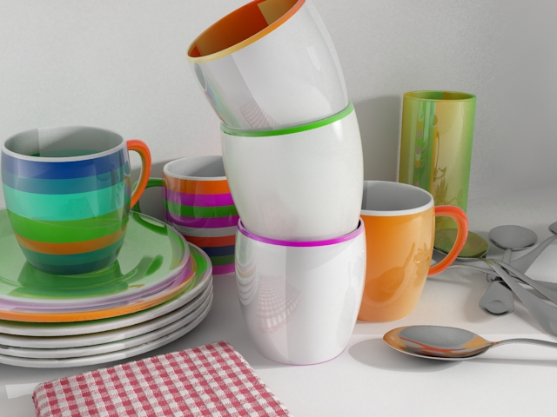
Alexandra Constantin

Slide 3
Dirty Dishes

Slide 4
Enthusiasm, eagerness, and preparation for Christ’s soon return have everything to do with Stewardship

Slide 5
“
Who then is the faithful and wise servant, whom the master has put in charge of the servants in his household to give them their food at the proper time? It will be good for that servant whose master finds him doing so when he returns.
”
Matthew 24:45-46, NIV.

Slide 6
“
Then the man who had received one bag of gold came. “Master,” he said, “I knew that you are a hard man, harvesting where you have not sown and gathering where you have not scattered seed. So I was afraid and went out and hid your gold in the ground. See, here is what belongs to you.

Slide 7
“
His master replied, “You wicked, lazy servant! So you knew that I harvest where I have not sown and gather where I have not scattered seed? Well then, you should have put my money on deposit with the bankers, so that when I returned I would have received it back with interest.
”
Matthew 25:24-27, NIV.

Slide 8
“
If it falls your lot to be a street sweeper, sweep streets like Michelangelo painted pictures, sweep streets like Beethoven composed music, sweep streets like Leontyne Price sings before the Metropolitan Opera.

Slide 9
“
Sweep streets like Shakespeare wrote poetry. Sweep streets so well that all the hosts of heaven and earth will have to pause and say: Here lived a great street sweeper who swept his job well.

Slide 10
“
If you can’t be a pine at the top of the hill, be a shrub in the valley. Be the best little shrub on the side of the hill. Be a bush if you can’t be a tree. If you can’t be a highway, just be a trail. If you can’t be a sun, be a star. For it isn’t by size that you win or fail. Be the best of whatever you are.
”
Martin Luther King, Jr., “Street Sweeper.”

Slide 11
God expects us to effectively and efficiently manage our time to do our best for the sake of kingdom growth.

Slide 12
Use the inner resources that God has placed inside of you to make things happen.

Slide 13
God is calling us to be good managers, good stewards, of His money.

Slide 14
Ownership has an inward focus;
Stewardship has an outward focus.
Ownership is temporal;
Stewardship is eternal.
Ownership can put its emphasis on you;
Stewardship puts its emphasis on others.

Slide 15
Photo by Daniel Páscoa on Unsplash
“
Lo, this is our God we have waited and worked, and He has come to save us!”

